Slide 1
College of Engineering New Graduate Student Orientation
Fall 2024

Slide 2
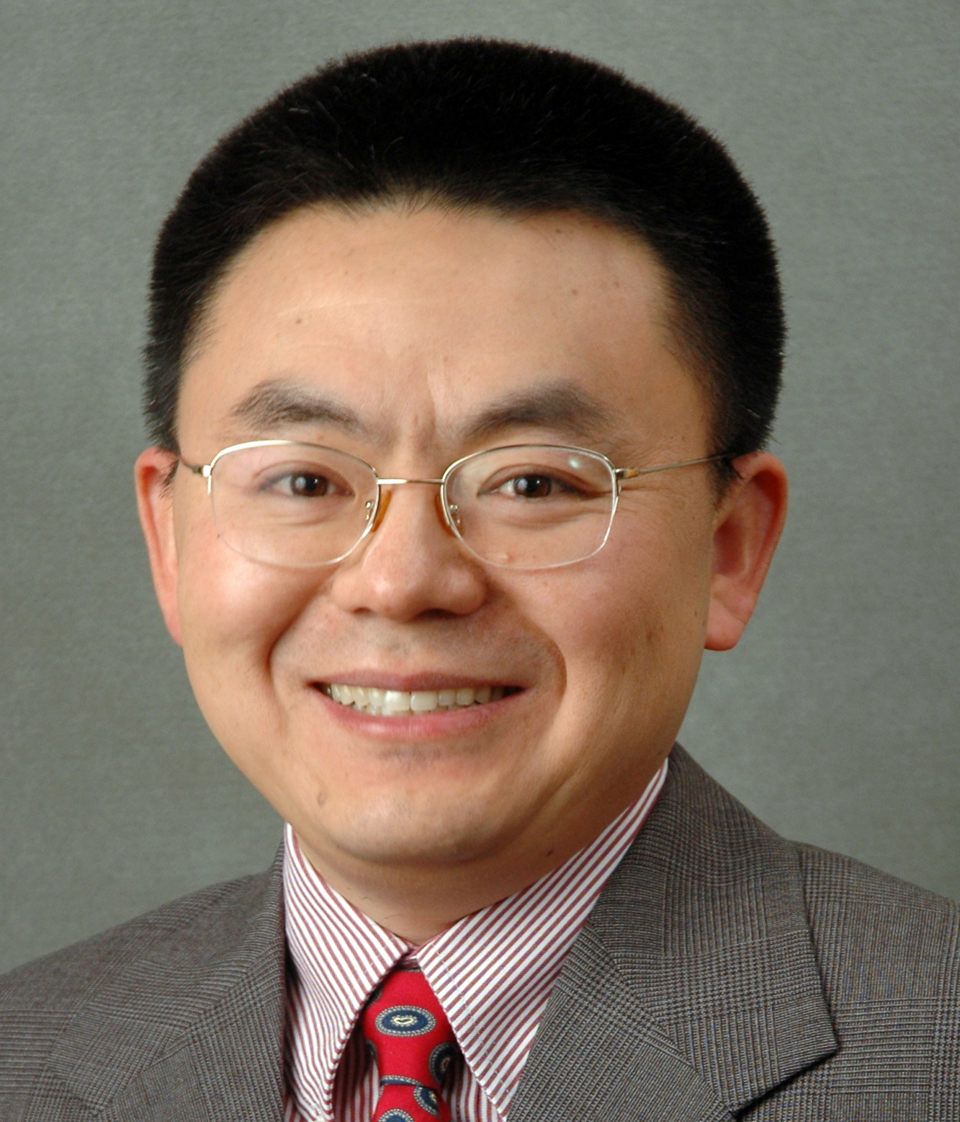
Welcome from
Ji-Cheng 'JC' Zhao, Ph.D.
Dean of College of Engineering
Julia Valla, Ph.D.
Director of Graduate Studies

Slide 3
COE Graduate Council Introduction
Julia Valla, Ph.D.
Director of Graduate Studies, Assistant Professor, Chemical & Biomolecular Engineering

Slide 4
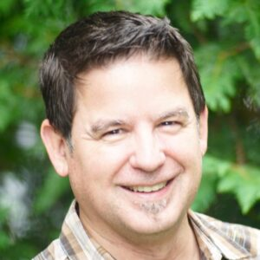
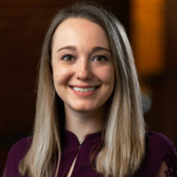
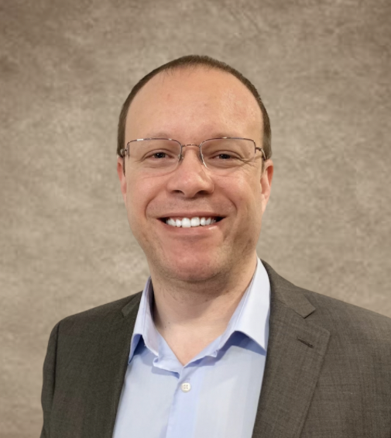
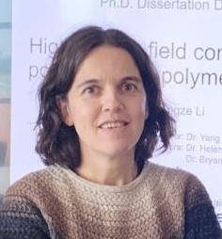
Graduate Directors
Monty Escabi, Ph.D.
Biomedical Engineering
Alexandra Hain, Ph.D.
Civil Engineering
Julian Norato, Ph.D.
School of Mechanical, Aerospace, and Manufacturing Engineering
Helena Silva, Ph.D.
Electrical & Computer Engineering

Slide 5
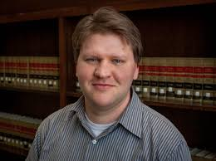
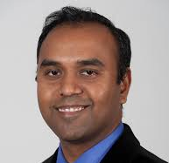
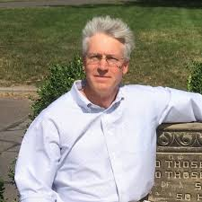
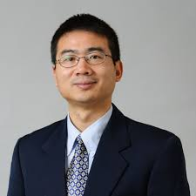
Graduate Directors
Tim Vadas, Ph.D.
Environmental
Engineering
Avinash Dongare, Ph.D.
Materials Science & Engineering
Alexander Russell, Ph.D.
School of Computing
Luyi Sun, Ph.D.
Chemical & Biomolecular Engineering

Slide 6
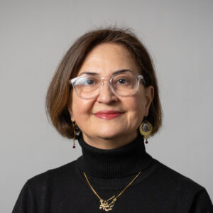
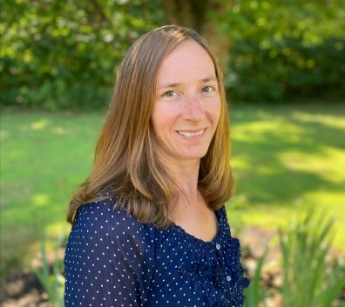
Meet the Graduate Programs Team
Aida Ghiaei
Director of Graduate Outreach & Diversity
Fayekah Assanah
Director of Engineering Education Initiative
Jodie LaRosa
Program Assistant

Slide 7
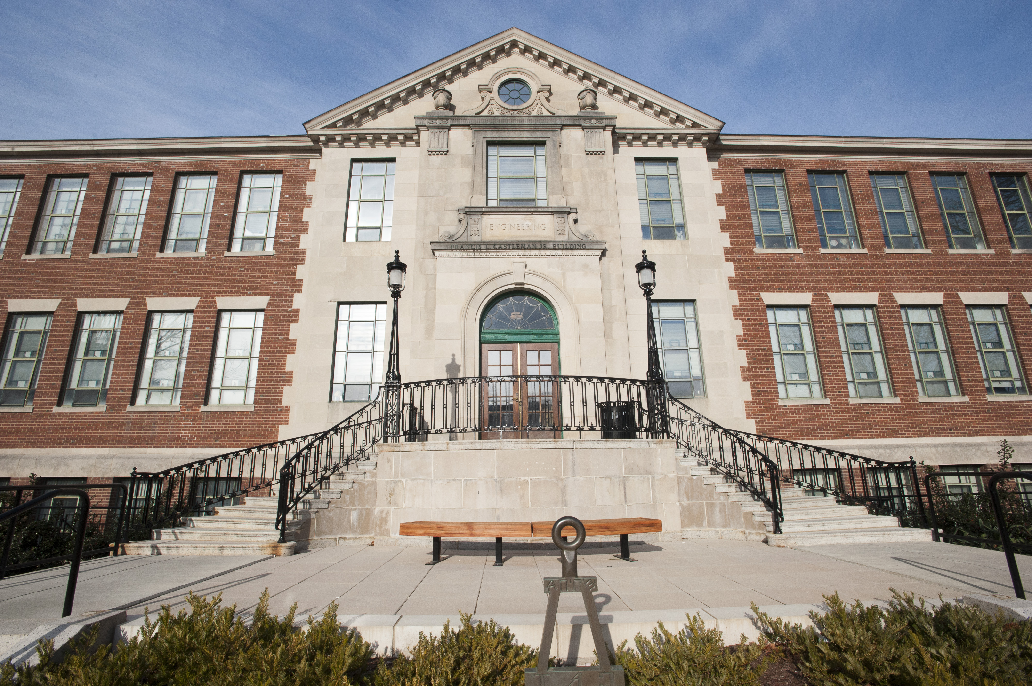
FIND US IN THE CASTLEMAN BUILDING

Slide 8
Agenda
Agenda
Student resources
Student health and wellness
Navigating Grad School
Lunch with student representative
Graduate student Union presentation

Slide 9
Student Resources
COE Graduate Council Introduction: Ioulia Valla
Graduate Student Resource and Support: Aida Ghiaei
Carrier Services: Theo Menounos
Professional Development Courses: Fayekah Assanah
Engineering Technical Services: Pete Menard
Agenda

Slide 10
Graduate Student Resource and Support
Aida Ghiaei
Director of Graduate Recruitment, Support & Engagement

Slide 11
Notes:
Who AM I?

Slide 12
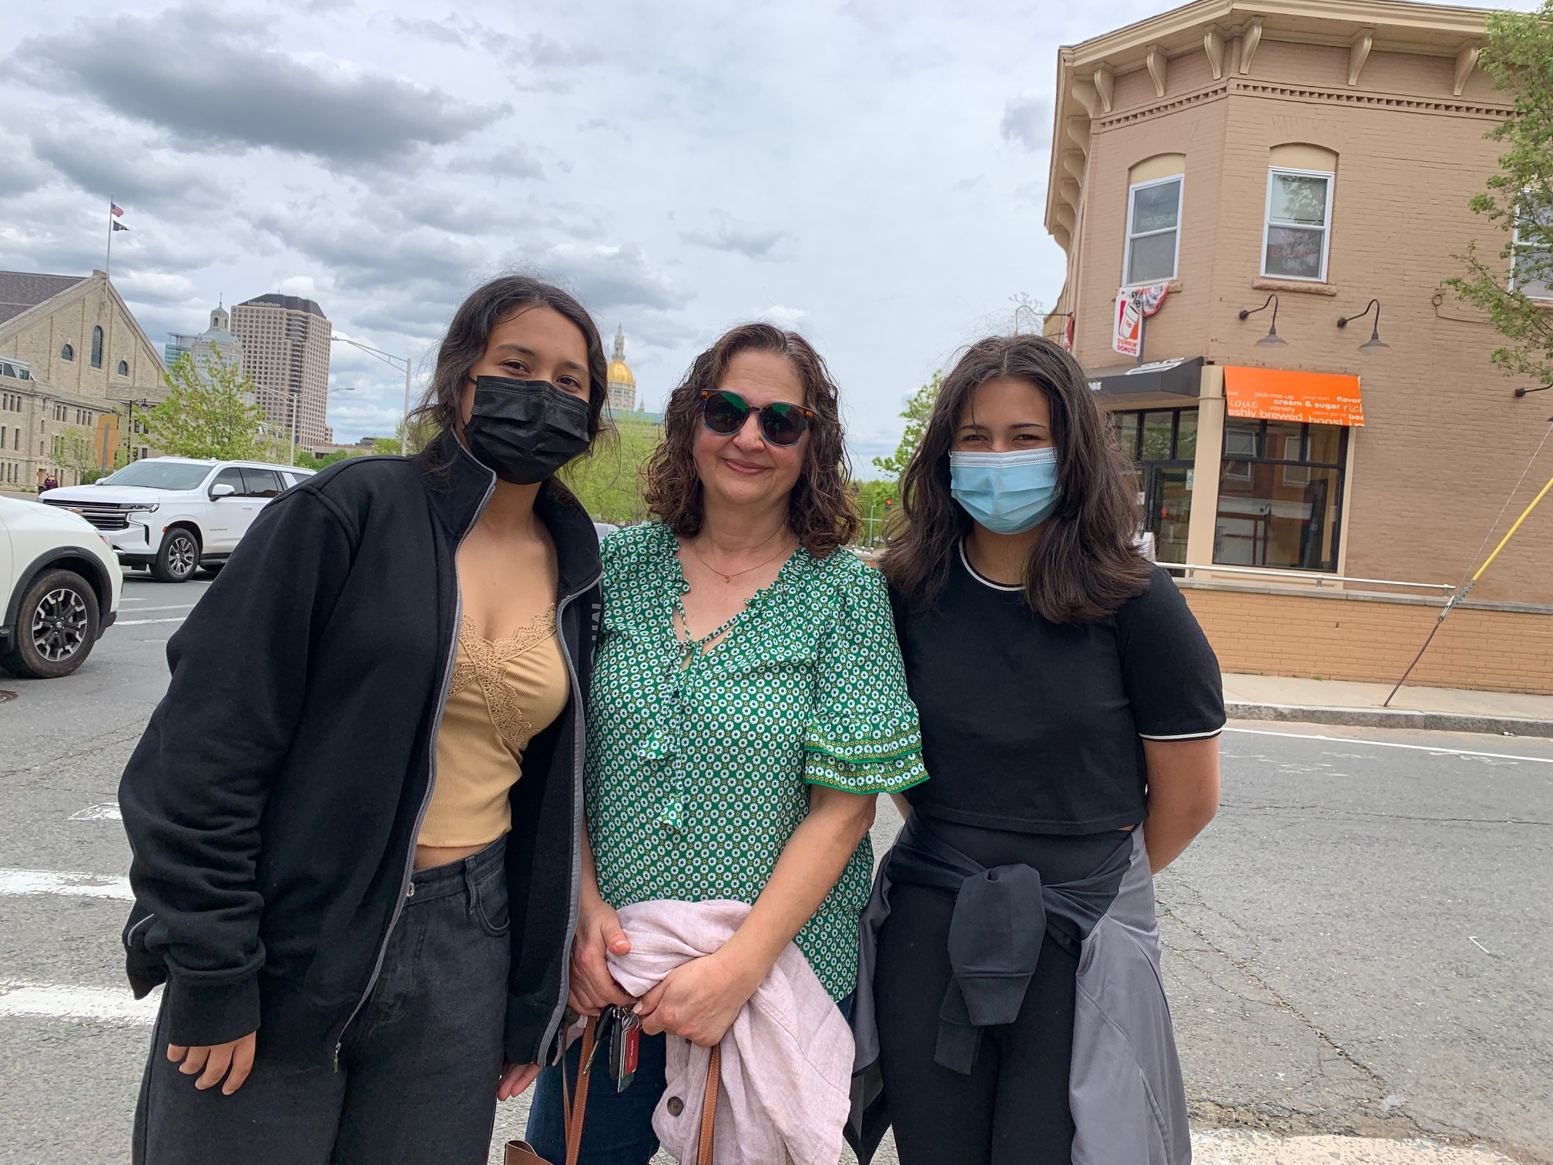
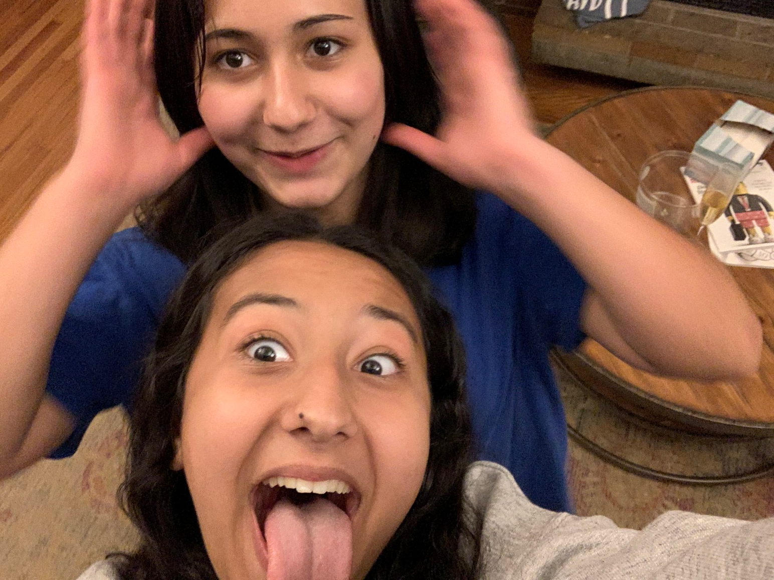
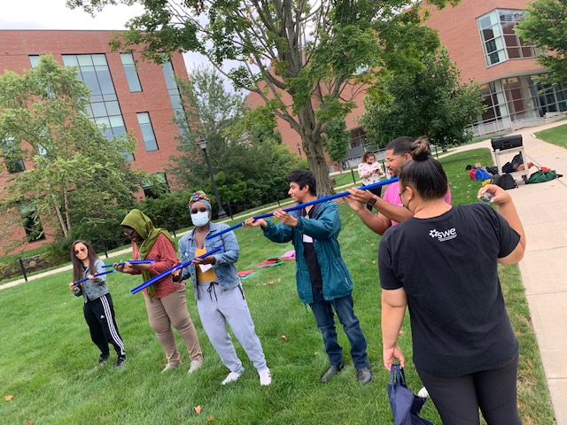
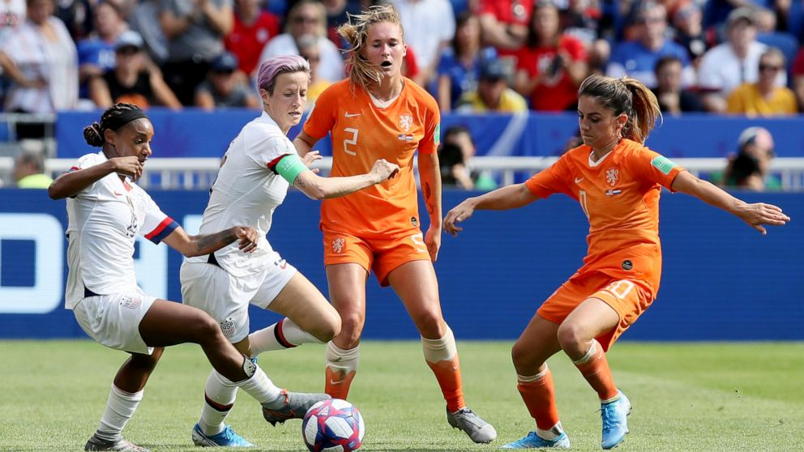
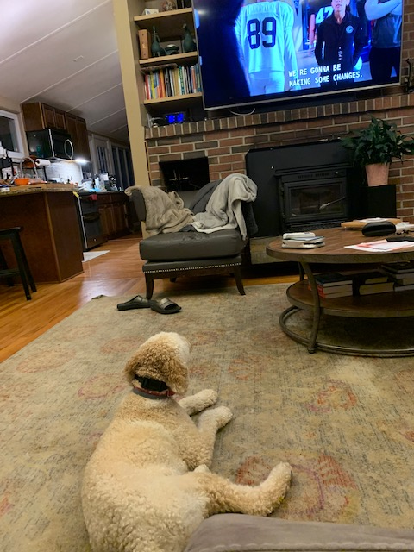
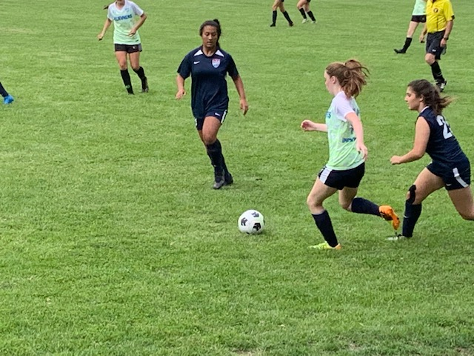
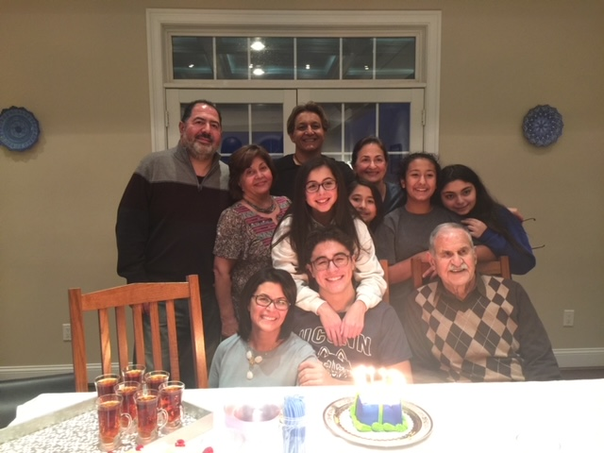
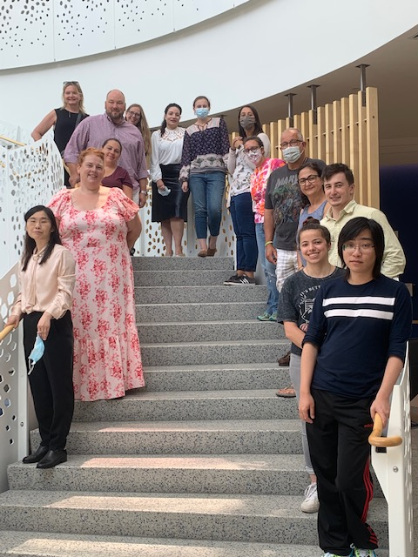
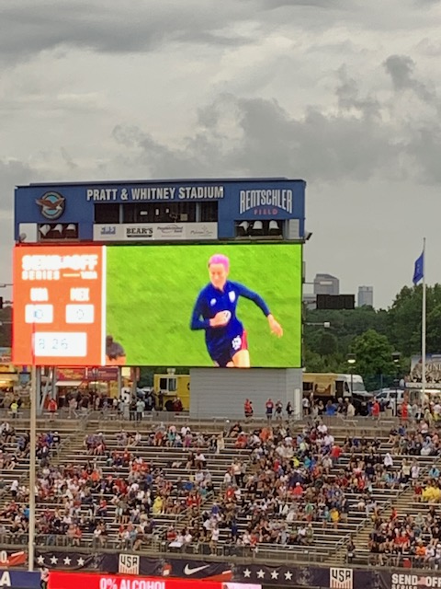
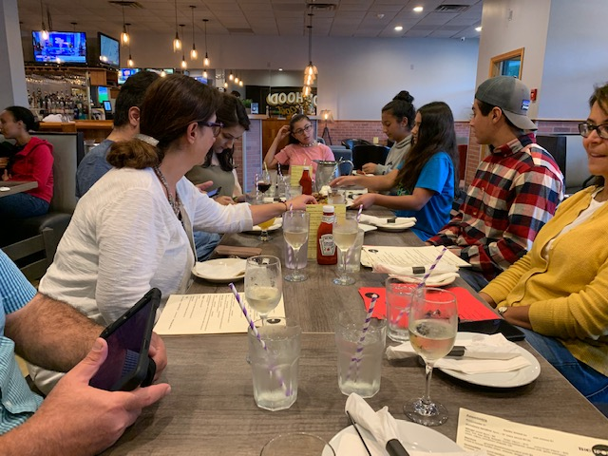
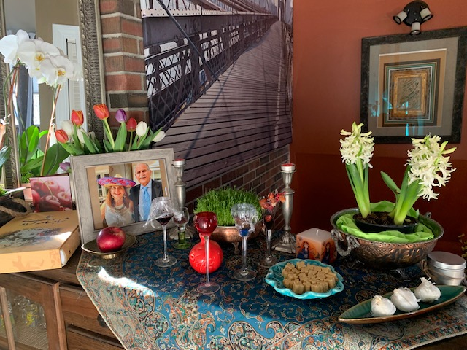
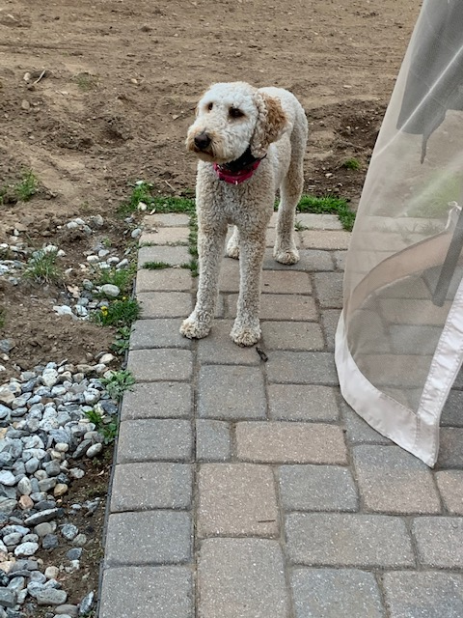
Notes:
I am from Iran
Mother of 2 teenagers and a dog
Soccer family
Both girls play club and school soccer
Even my dog- very good defense player –Ball does not pass him

Slide 14
#1
Graduate students’ Mental health and Wellbeing
Any questions, concerns, issues, I can help
My Door is Always Open (Castleman bldg. 222)

Slide 15
#2
Recruit for Engineering Graduate programs
National Engineering Conferences
Colleges in CT, MA, RI, NH
Hold Open houses
Presentation to UConn STEM undergrads
Notes:
The rest are number 2 s

Slide 16
#3
Professional Skills Development
Courses
Workshop
Seminars
Webinars
Notes:
The rest are number 2 s

Slide 17
#4
Everything Else that would help
our Graduate Students
Notes:
The rest are number 2

Slide 18
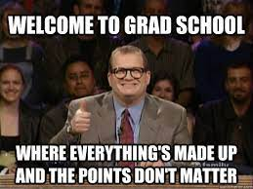
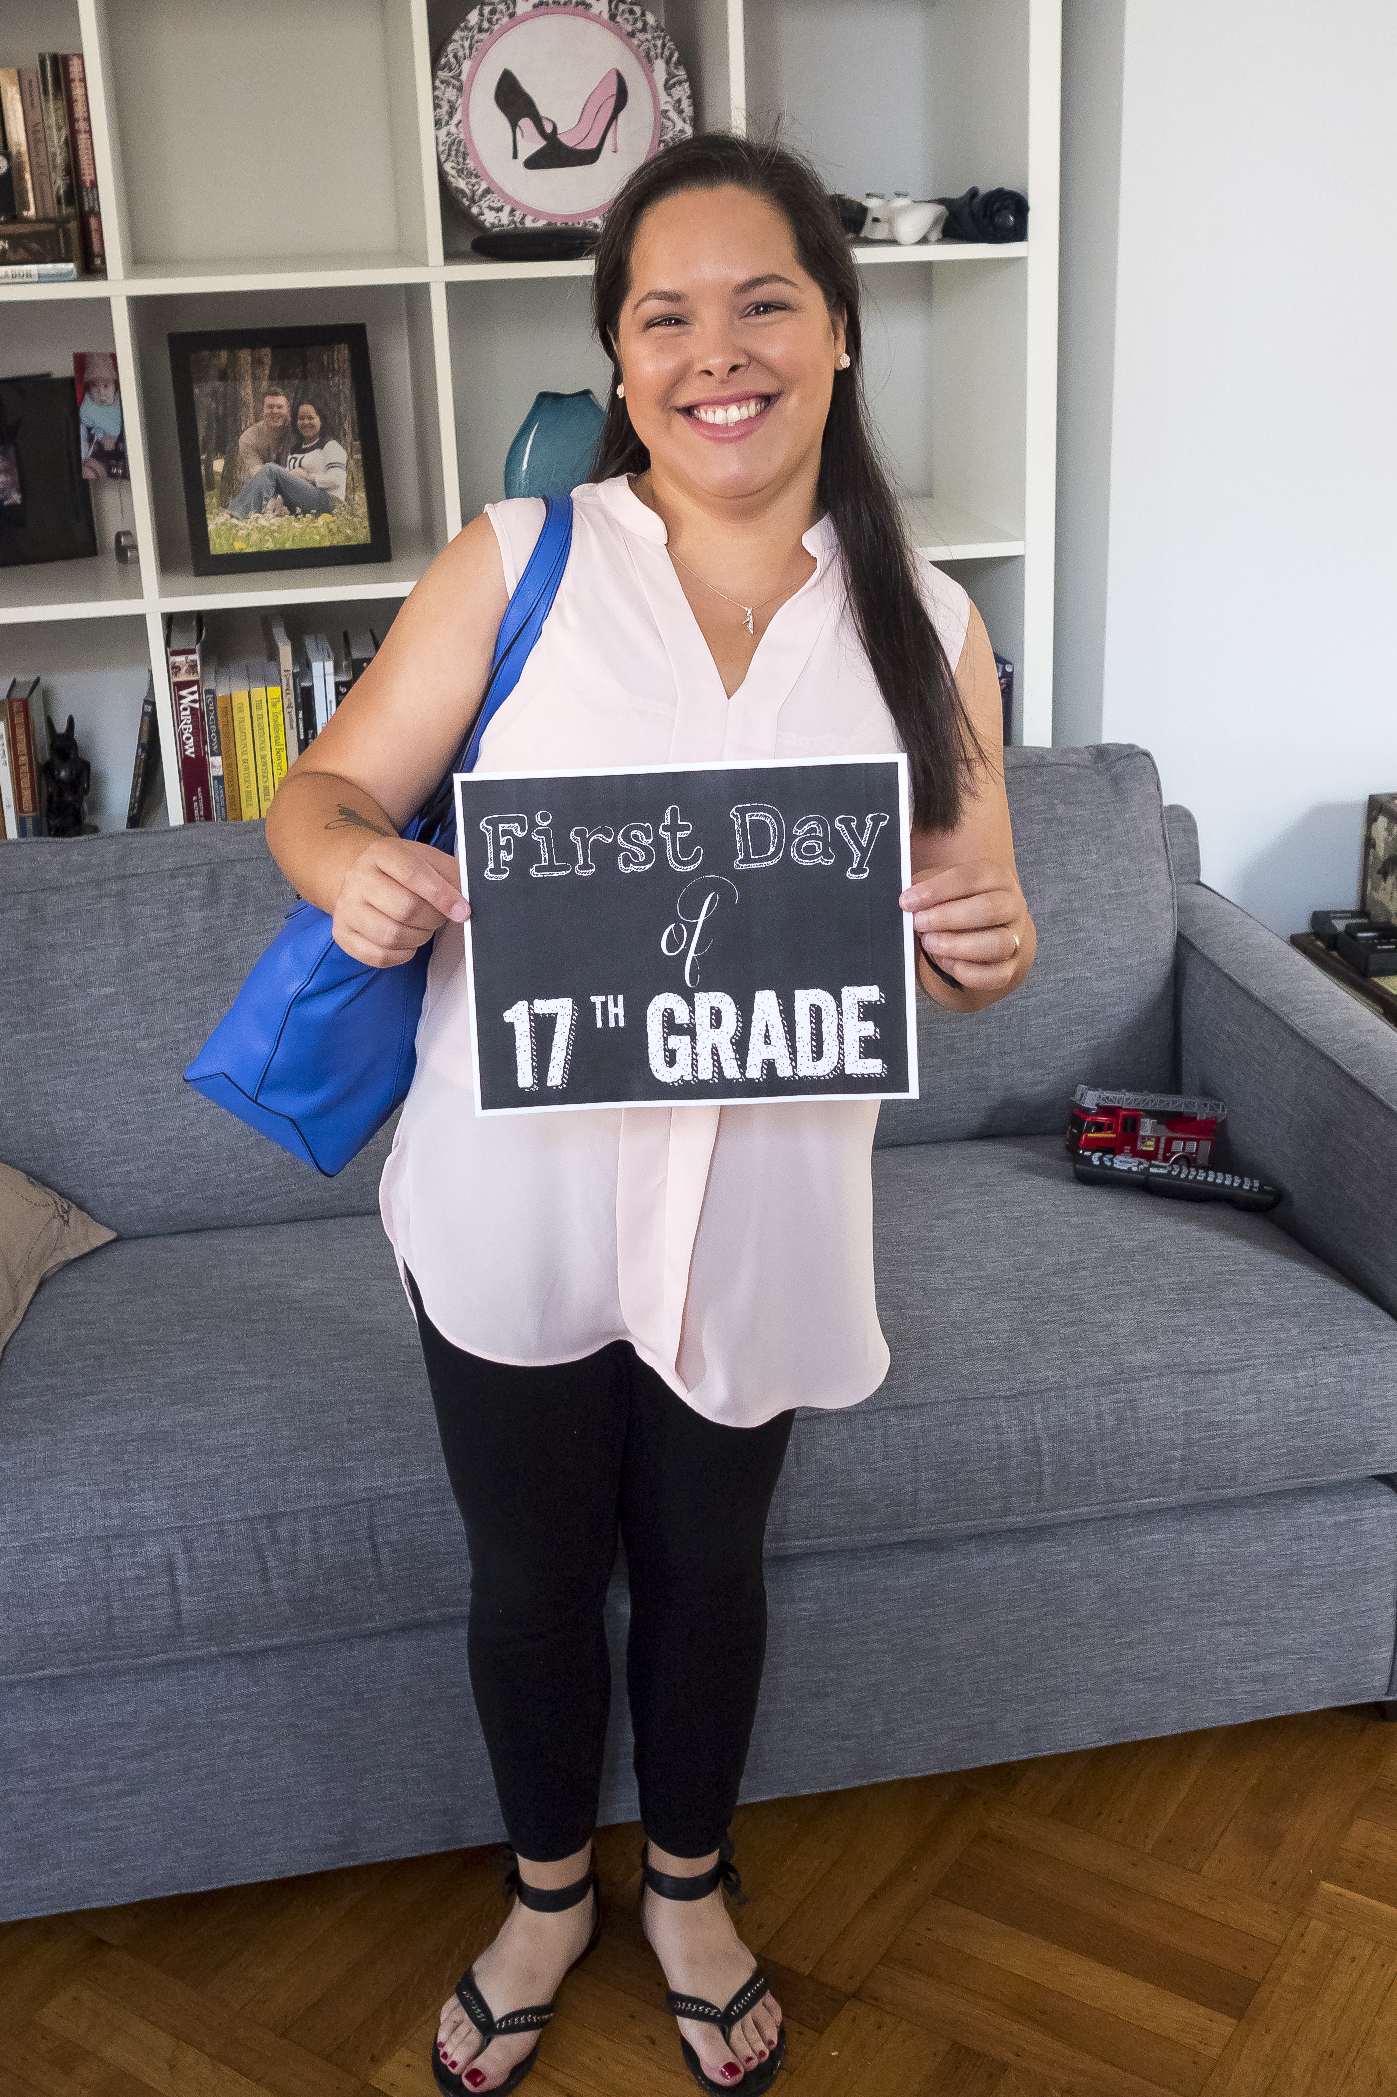
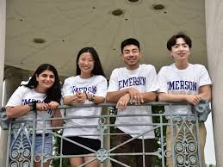
ENGR 5450: First Year Experience
Notes:
FYE class help you to get the foggy idea of being in graduate school to clear vision
Helps you to meet new people and start building your community
I wish I knew this my first year…
being successful Graduate students
Community
Mentors
Advocates
Who are you
Who decides your success
And …
Register to find out answers to all your questions

Slide 19
Just Ask Us:
aida@uconn.edu

Slide 20
Engineering Technical Services
Grad Student support offerings

Slide 21
How do i?
Get lab experiment help?
https://ets.engr.uconn.edu/innovation-shop/
Support designing and building fixtures
Electronics support
Learn to use the shop equipment
Get computer tech support?
Email to engr-help@uconn.edu
Support with lab network setup
Solving software issues – install and running
Computer hardware support
Server support

Slide 22
Experiment or EHS support
Start a new experiment
UConn EHS
Chemical waste handling
New gas lines
Furnace setups
Facility modifications for lab challenges
Get Pete Menard involved pete@uconn.edu
Toxic gases
Exhaust issues
Facility problems (i.e. broken ventilation)
Don’t know how to manage a problem? Contact Pete..

Slide 23
Engineering Career Services

Slide 24
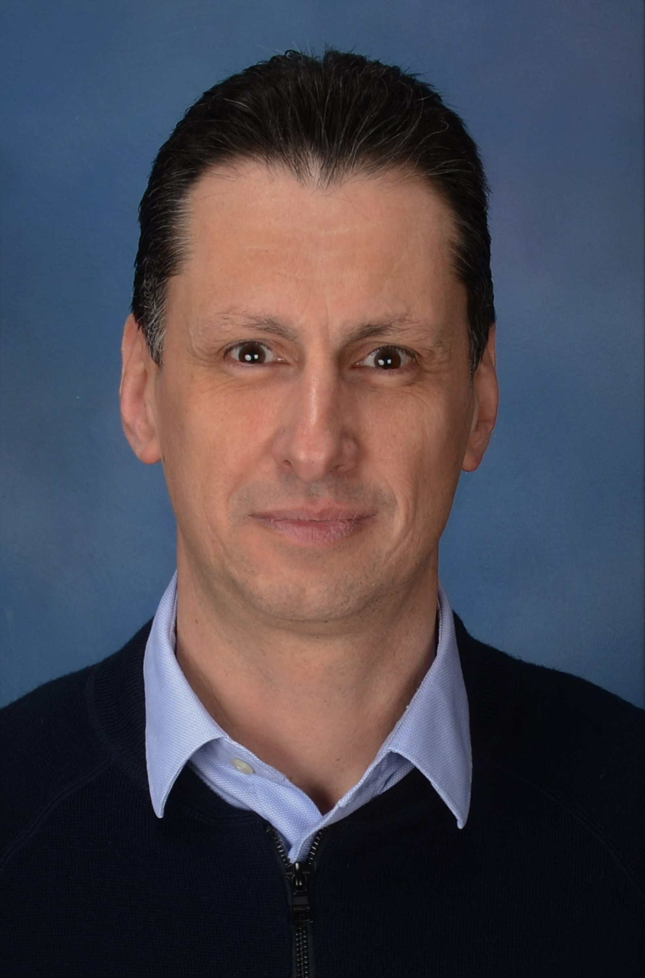
Engineering Career Services
Theo Menounos​ Assistant Director, College of Engineering Career Readiness Lead, Center for Career Development

Slide 25
Professional Development Courses

Slide 26
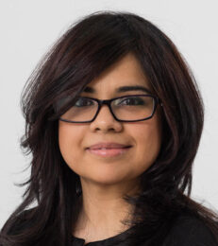
Professional Development
Fayekah Assanah, Ph.D.
Assistant Professor in Residence, BME
Director of Engineering Education Initiatives

Slide 27
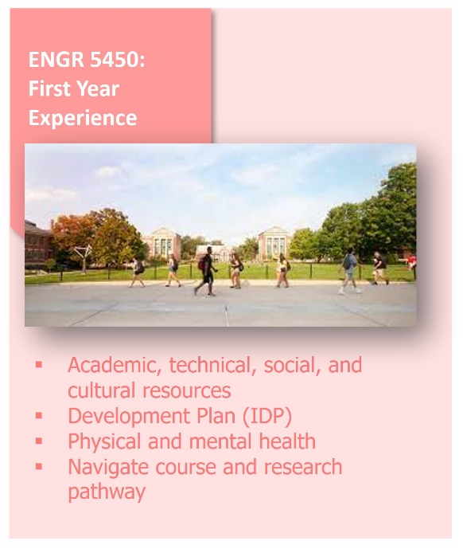
Professional Development Course Contents
Center for Career Development
Contact: Faye Assanah, Fayekah.Assanah@uconn.edu
Aida Ghiaei, aida@uconn.edu

Slide 28
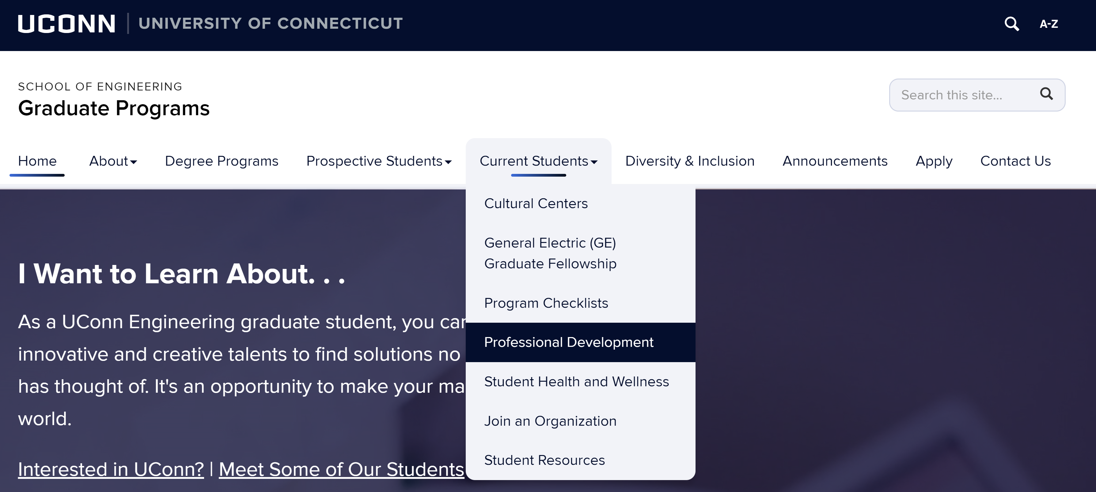
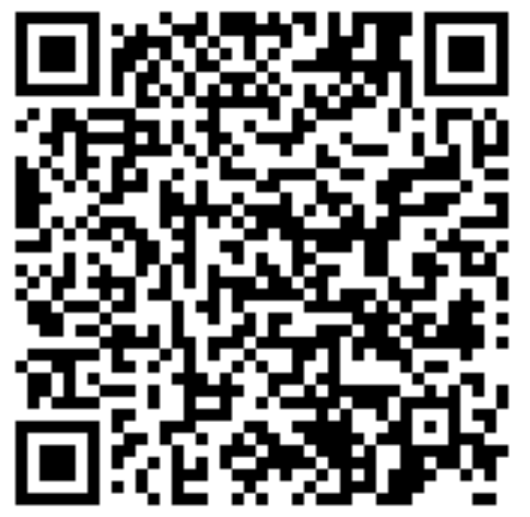
Professional Development Course Series
Series of 1-credit courses for all CoE graduate students
Develop interpersonal and professional skills
Offered on a rotating basis during Fall and Spring
No pre-requisites
Where to find more information?
ENGR 5410: Scientific Communication
ENGR 5420: Engineering Internships and Career in Industry
ENGR 5450: First-Year Experience
ENGR 5300-012: Scientific Writing
ENGR 5300-011: Engineering Practicum
Fall:
Website:
ENGR 5300-002: First-Year Experience
ENGR 5430: Teaching Engineering- Communication and Pedagogy
ENGR 5300-011: Engineering Practicum
Spring:
Workshops:
The Art of Negotiation
3MT Preparation

Slide 29
Agenda
Student resources
Student health and wellness
Navigating Grad School
Lunch with student representative
GRADUATE STUDENT UNION PRESENTATION

Slide 30
Student Health and Wellness
Creating a Culture of Wellness

Slide 31
Student Health and Wellness’ Vision
Cultivate optimal health and lifelong
well-being
for every UConn student

Slide 32
UConn Student Health and Wellness
SHaW Service Lines:
Medical Care Pharmacy Mental Health Health Promotion
Hilda May Williams Building 234 Glenbrook Road
860-486-4700
Arjona Building 4th Floor
337 Mansfield Road
860-486-4705
Wilson Building South Campus
860-486-9431

Slide 33
Overview of SHaW Services
Medical Care and Pharmacy:
Primary Care
Women’s Health
Orthopedics and Sports Medicine
Nutrition Services
Sexual Assault Services (SAFE)
Gender Affirming Care
24 Hour Advice Nurse Line
Allergy and Travel Medicine
Pharmacy
Radiology
Overnight Infirmary
Mental Health:
Wellness Resources
Let’s Talk
Consultation
Group Therapy
Individual Therapy
Medication Management
Crisis Support
Clinical Case Management
Health Promotion:
Wellness Coalition
Collective Impact Approach
Wellness Framework
UConn Recovery House

Slide 34
Graduate Student Well-being
The past ten years have seen mounting evidence that graduate students are facing increasing levels of stress and anxiety.
According to a recent study involving a survey of 3500 graduate students at twelve public institutions during the COVID-19 pandemic, 67% of survey respondents scored low on well-being factors (CGS_JED_Grad-Student-Mental-Health-Report-1.pdf (cgsnet.org))

Slide 35
Impact and opportunities
Overall, rates of self-reported depression and anxiety are six times higher among graduate students compared to those of the general population and higher than their same-aged, college educated peers.
Positive factors related to lower levels of depressive symptoms, include social support, climate of the department, and optimism about one’s career prospects
Positive factors related to graduate student mental health (2020) Full article: Positive factors related to graduate student mental health (tandfonline.com)
Notes:
KM

Slide 36
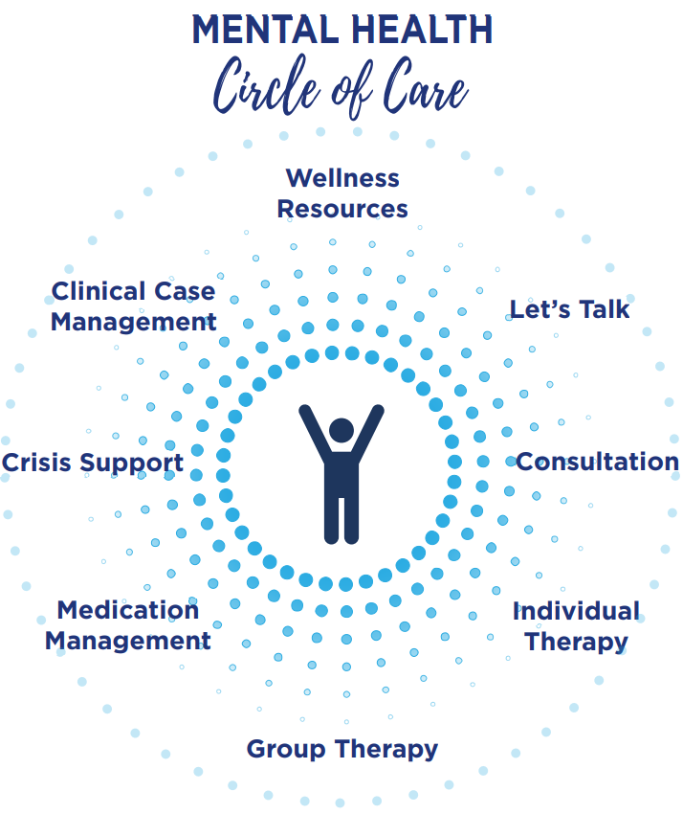
SHaW Mental Health
Who we are: The right supports at the right time.
Student Health and Wellness Mental Health works closely with University partners to offer a comprehensive range of options to meet students’ needs.
Offering students access to a personalized approach that promotes wellbeing and meets their mental health needs by offering
Rapid access to
solution focused, student centered approach
using interventions with proven outcomes
to meet the diverse needs
of our students
throughout their college experience
Notes:
The Student Health and Wellness Mental Health team includes a team of licensed practitioners who deliver a range of services. This graphic outlines the various ways a student may interact with the mental health team through a rapid access response that is solution focused, student centered, leverages interventions with proven outcomes and is able to meet the diverse needs of all students regardless of where they are in their collegiate experience.
Starting with Wellness Resources which come in the form of mindfulness, meditation, yoga and online self directed resources that students can access
Let’s Talk is an informal consultation appointment with a clinician. This is a great option for students who may need some quick advice of want to better understand the counseling experience. We also offer Consultation available to staff, faculty, parents and other students who may be concerned about a student and want to talk with a clinician
We offer two primary treatment modalities which are:
- Group Treatment - offers students the opportunity to address issues commonly experienced by college students in a confidential, supportive manner.
- Individual Treatment - is a brief solution focused, student centered approach focused on current life circumstances.
In addition, we offer:
Medication Management is also available for those students needing psychotropic medication
Crisis Support provides clinical assessment for urgent OR emergent mental health issues and is available 24/7/365 whether you are on campus, off campus, an international student at home or studying abroad
Clinical Case Management – works closely with students who are stepping down from a higher level of care, are in need of specialized treatment or who may have long term treatment needs

Slide 37
24 Hour Services
These services are available to students on all UConn campuses
Advice Nurse
860-486-4700
Mental Health Support​
Within the U.S., Canada and the Caribbean:
833-308-3040
All other international locations:
+1-984-268-2016
Togetherall
Peer to Peer Support​

Slide 38
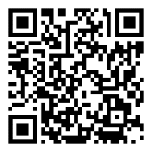
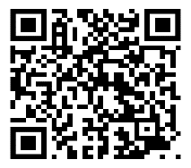
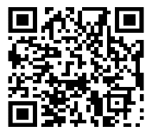
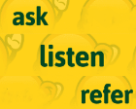
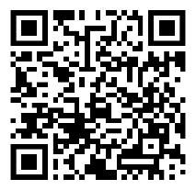
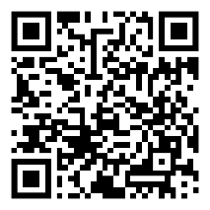
Tools | Overview | Audience | Access | Time to complete
Self-guided Screening
 | Online screening program that offers a simple, confidential way for students to check on their behavioral health and get connected to campus resources. | Students |  | Multiple screenings to choose from. Each takes between 3-5 minutes.
Mental Health Support
 | Clinically managed, online anonymous peer to peer community designed to improve mental health | Students |  | Real access to support network
 | 24/7/365 mental health support line 833-308-3040 (U.S., Canada and the Caribbean) Or +1-984-268-2016 for all other international locations | Students |  | Immediate contact with a licensed practitioner
Mental Health Training
 | Online suicide prevention training program to help recognize and respond to people at risk. | Students, Faculty & Staff |  | 20 minutes
 | Interactive simulated training that allows faculty, staff and students to practice having important and life-saving conversations with students who are experiencing distress. | Students, Faculty & Staff |  | 40 minutes

Slide 39
SHaW Mental Health Contact Information
Phone: 860-486-4705
Website: https://studenthealth.uconn.edu/
Social Media: @uconnstudenthealth (Instagram)

Slide 41
Questions?

Slide 42
Agenda
Student resources
Student health and wellness
Navigating Grad School
Lunch with student representative
GRADUATE STUDENT UNION PRESENTATION

Slide 43
Networking and Leadership Panel
SAGE, Grad SWE, JLLA, Black STEM, ITE, Grad SHPE
Managing Multiple Rolls as a Graduate Student-Ioulia Valla
Round table discussions with student leaders
Agenda
Navigating Grad School

Slide 44
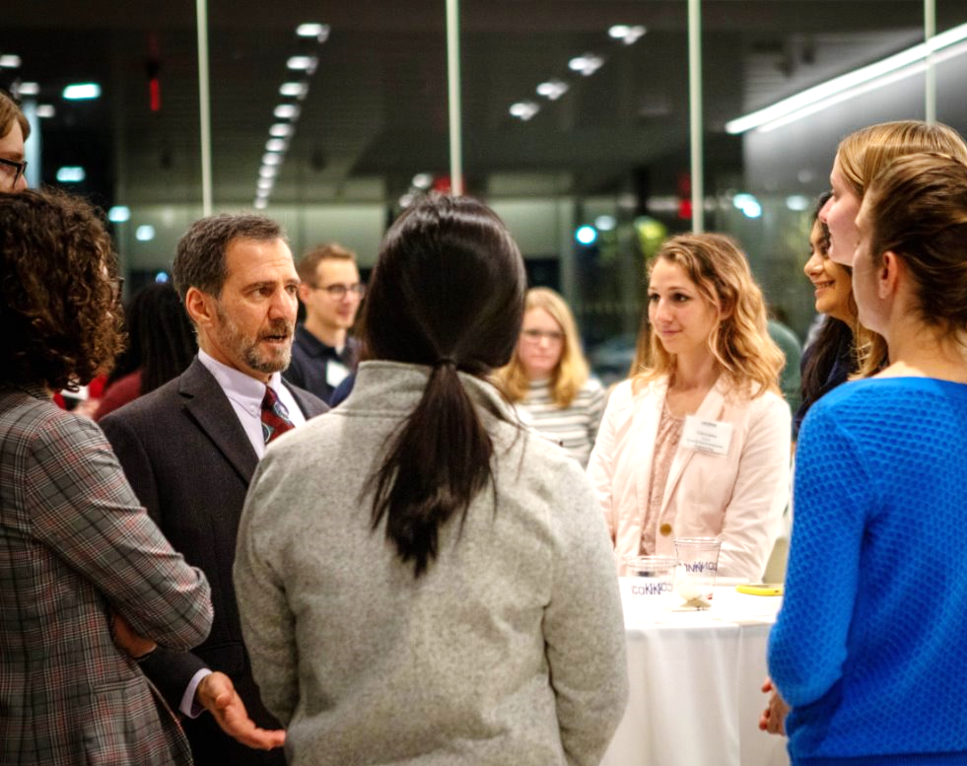
Graduate Student Leaders

Slide 45
Welcome
To
Student Association of Graduate Engineers (SAGE)

Slide 46
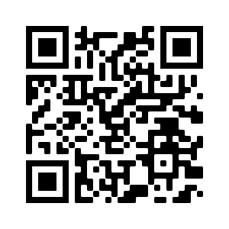
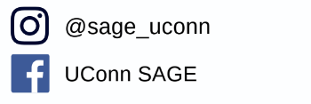
Follow us on Instagram and Facebook or email us to be added to our mailing list for the updates of future events!
Who are we?
An organization for the graduate students of all engineering programs
What do we do?
Host workshops, social events, & professional development programs
What are the benefits of SAGE membership?
We help students to develop professional skills, connect with professional networks, engage in fun-activities with peers and much more!

Slide 47
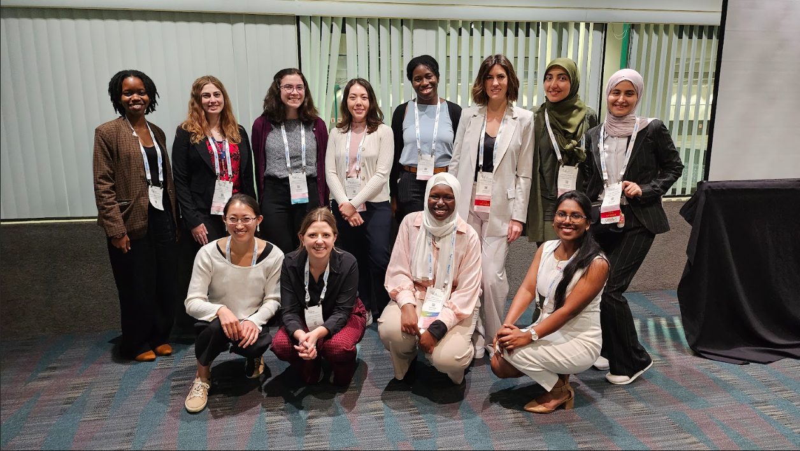
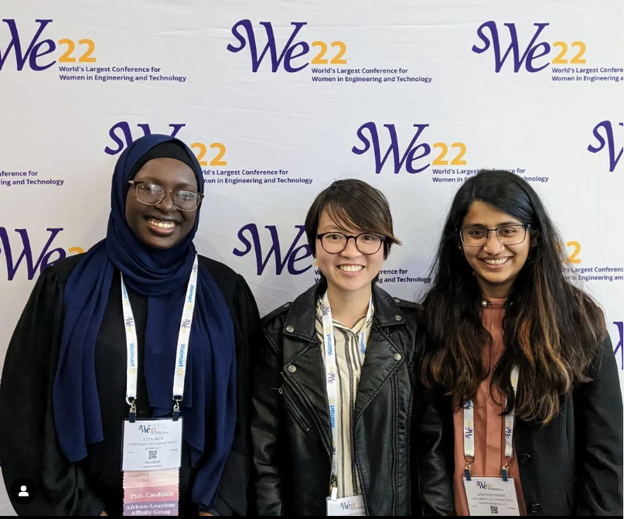
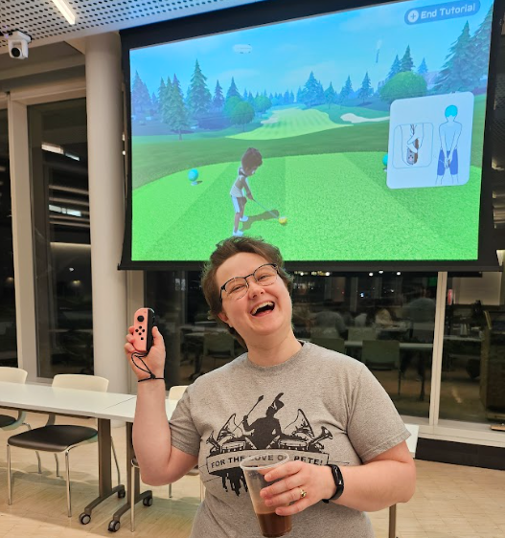
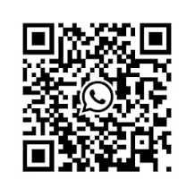
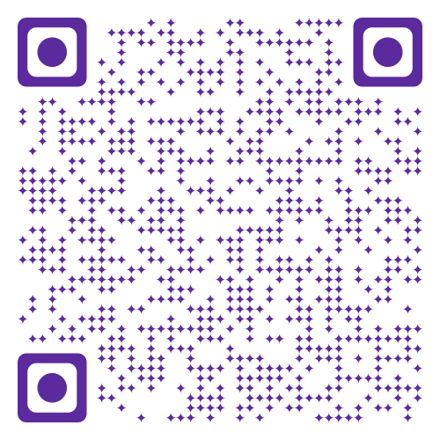
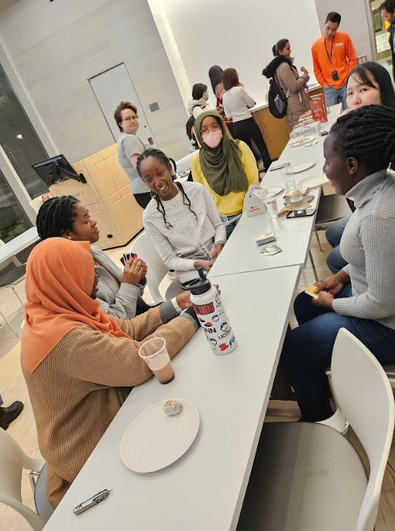
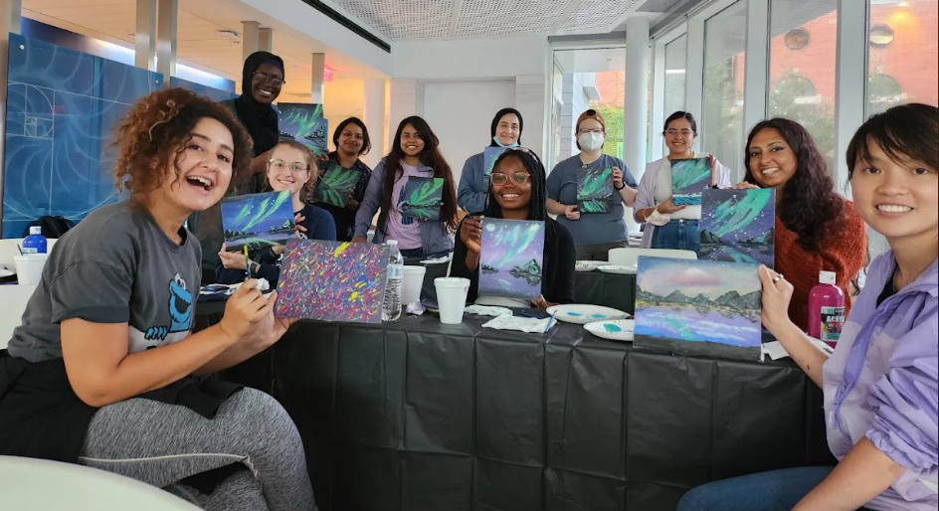
Graduate Society of Women Engineers
Who We Are
Upcoming Events
We aim to empower graduate women engineers and in STEM to find an inclusive community, develop their career and research academic skills, and achieve their full potential. We celebrate the intersectionality of all our individual identities to bring a sense of belonging and advocacy in our respective fields.
Welcome Game Night | Sept 11
Monthly Coffee Hours | Sept 24
Academic Careers Panel | Oct 9
Industry Careers Panel | Oct 23
Job Application and Interview Workshop | Nov 6
Connect with Us!
UConntact
WhatsApp
uconnswe.grad@gmail.com
Instagram: @gradswe_uconn

Slide 48
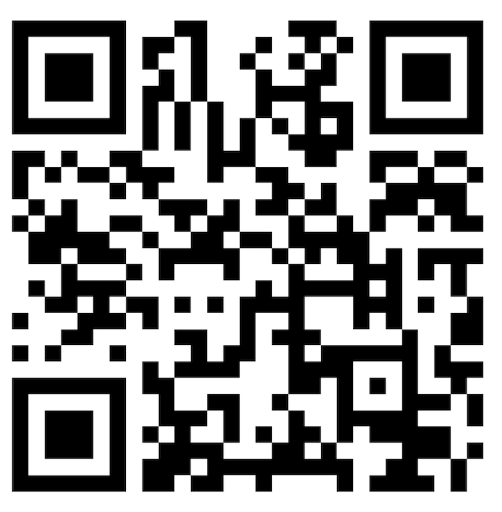
We Are Recruiting!
Are you enrolled in a M.S. or Ph.D. Engineering Program and want to become a future leader?
﻿If so, the John Lof Leadership Academy (JLLA) is the perfect place for you!
﻿DEADLINE:
23 AUG 2024
Breakout group scenario discussion at the leadership feedback skills workshop
Nov 28, 2023
Panel Discussion with Engineering Department Heads event for JLLA members to learn more about a career in academia
May 8, 2024
@lofuconn
John Lof Leadership Academy
48
jlla.engr.uconn.edu

Slide 49
Hosted in partnership with the College of Engineering John Lof Leadership Academy

Slide 50
ITE - UConn Student Chapter

Slide 51
Officer Introduction
President: Quinn Packer
Vice President: Haimanti Bala
Treasurer: Syed Islam
Secretary: Prakash Ranjan
Advisor: Anshu Bamney

Slide 52
BlackSTEM
President/Adanma Akoma
Vice President / Hamida Nadoya
Secretary / Wilfred Elliam
Treasurer / Sita Nyame
Broader Impact Chair / Nana Yaw
Intellectual Merit Chair / John Ajayi
Research Relief Chair / Richard Afatsao
Professional Presence Chair / Oluwafemi Sanumi

Slide 53
BlackSTEM
Who We Are!
Professional Presence
What We Gain!
The BlackSTEM organization was established in 2020 (formerly known as the graduate chapter for the National Society of Black Engineers at UConn). In essence, we align ourselves with the core values inspired by NSBE, however, we aim to magnify the voices of all Black scholars throughout the African diaspora who are not only engineers but are within all STEM disciplines.
“Come one, come all Black grad students in STEM! This place is for you!”
Through collaboration and sponsorship, we are equipped to execute initiatives that speak to the needs of BlackSTEM students at UConn.
Broader Impact
Intellectual Merit
What We Do!
Research Relief

Slide 55
Multiple roles of graduate students
Acknowledge All Your Roles
Set Realistic Expectations
Time Management and Boundaries
Prioritize and Be Flexible
Integrate Roles When Possible
Self-Care and Personal Time
Seek Support
Stay Organized and Efficient
Embrace Imperfection

Slide 56
Agenda
Student resources
Student health and wellness
Navigating Grad School
Lunch with student representative
GRADUATE STUDENT UNION PRESENTATION

Slide 57
Graduate Employee and Postdoc Union
GEU-UAW Local 6950
Improving the Graduate Worker and Postdoc Experience at UConn
uconngradunion.org
uconngradunion@gmail.com
Notes:
Names, department, role in the GEU
We’re here to give you a quick summary of the improvements we have won through our union at UConn, explain the importance and encourage you to sign up as members of the union, and answer any questions.
Please note that this presentation is for Graduate Assistants which is an umbrella term for teaching assistants and research assistants. Fellows do not fall under our contract nor do GAs at UConn health. But, if either of these apply to you we are always more than happy to assist you with any questions or concerns you may have.

Slide 58
Overview
What is a Labor Union?
Why We Started the GEU
Highlights of Improvements
Importance of Membership
Strengthening Our Voice beyond UConn
Q&A
Notes:
Today we’ll be touching on the following topics:
What is a Labor Union?
Why We Started the GEU
Highlights of Improvements
Importance of Membership
Strengthening Our Voice beyond UConn
Q&A

Slide 59
What is a labor union and what does a labor union do?
Notes:
A labor union is an organization that creates a collective voice and collective power for workers. We advocate together for good working conditions, fair treatment, and to overcome challenges in our working environments

Slide 60
Addressing Systemic Challenges
Larger Social Attitudes/Norms
Institutional Policies/Norms
Work Environment
Supervisors/ Coworkers
Individual
Notes:
Many of our members have faced and continue to face challenges with caring for themselves and their families, managing emotional and financial stress, and navigating changing university policies and federal laws. If we think of these as individual problems, we would just be chipping away at that part of the problem by ourselves, instead of considering the larger picture of systemic and institutional challenges.
Your work situation is part of a large ecosystem of values, attitudes, beliefs, and power relations. So when we are thinking the challenges that we face within our work as GAs, the cause of the challenge is often not coming from, or coming solely from, the individual or personal realm.

Slide 61
Organizing
Notes:
When we have a labor union and collective bargaining (see slide 25 for definition), instead of facing those problems alone, you’re surrounded by others who are fighting for the same thing and using their power together.

Slide 62
Organizing
Notes:
So when we have a labor union and collective bargaining—instead of standing in front of that insurmountable wall yourself, you’re surrounded by others who are fighting for the same thing, using their power together, and developing and acquiring tools to be able to take down that wall.

Slide 63
Creating Collective Power
A Strong Contract
Enforcing our Contract
Supporting & Engaging Members
Advocating at the Local & State Levels
Notes:
There are four main ways that we create collective power to ensure fairness and respect for all GAs at UConn.
First, we have a strong contract. Our most recent contract went into effect two years ago. Our ability to win this contract and future contracts relies on having a large majority of dues-paying members. This shows that we are committed as a union, and provides resources for the contract negotiation process.
Secondly, it’s not enough to have a contract on paper, we need to make sure it’s enforced. We enforce the contract by standing up for members’ rights both within and outside of the formal grievance process. Our staff and dedicated volunteers ensure that members are educated about and have support in defending their rights as members of the GEU.
Third, we are always working to support and engage our members by organizing within departments, communicating important resources and deadlines, and encouraging a sense of involvement and community through our monthly meetings, social media, and events.
Finally, we advocate at the local and state level for the needs and interests of GAs from local transportation to the state budget, we are actively advocating with elected officials, administrators, and decision-makers to ensure that the interests of GEU members are heard.
Firstly, we have a strong collective bargaining agreement. Our most recent contract was approved this year and went into effect on July 1st. Our ability to win this contract and future contracts relies on having a large majority of dues-paying members. This shows that we are committed as a union, and provides resources for the contract negotiation process.
Secondly, we enforce the contract by standing up for members’ rights both within and outside of the formal grievance process. Our staff and dedicated volunteers ensure that members are educated about and have support in defending their rights as members of the GEU.
We are always working to support and engage our members, making sure that we spend time on building walkthroughs, prioritize timely communication, and encourage a sense of involvement and engagement through our monthly meetings, social media, and regular communication with the whole membership.
Finally, we advocate at the local and state level for the needs and interests of GAs from local transportation to the state budget, we are actively advocating with elected officials, administrators, and decision-makers to ensure that the interests of GEU members are heard.

Slide 64
Organizing
GEU members at a solidarity march for striking UAW workers in Spring 2024
A Spring 2023 coffee hour at Fairfield Way (feat. Jonathan the Husky!)
GEU leaders and members at Spring 2022 work-in
Notes:
Here are some recent examples of organizing and outreach efforts led by the GEU members:
Left photo: the photo on the left shows a coffee hour held in Fairfield Way (the center of the Storrs campus) where GEU members hand out free coffee and pastries and speak with grad students about the union and grad school life in general
In addition to coffee hours, GEU members also do walkthroughs to meet with graduate students to learn more about graduate student needs and engage more folks in the union. A walkthrough is exactly what it sounds like! GEU members literally “walk through” departments on campus and meet face-to-face with graduate students to talk about their experiences, share educational resources about what the union does, and invite people to become more involved

Slide 65
Why we started the GEU
See https://www.uconngradunion.org/about-us.html for detailed history
Notes:
Before our union’s first contract in 2015, UConn could change our pay, benefits, and other work conditions unilaterally. By May 2013 working conditions worsened due to an HR decision to cut major healthcare benefits were so bad that HR basically took away health insurance while wages stagnated with increasing fees and workload (meaning you would be paying upwards of $300 just to walk in the door vs. a $15 copay with insurance). To emphasize that meant we would need to pay more from our wallets for a decline in health benefits. But by organizing over a thousand GAs from across all scientific and humanity departments to sign union cards we first got recognized. Additional sit-ins and protests by hundreds of GAs got us the contract. Like those GAs a decade ago, we still need to collectively advocate for ourselves and make improvements by unionizing our workplace, together.

Slide 66
Part of a Movement
Graduate Worker Unionization is Booming Across the Country
UAW grad workers at the University of California
The number of unionized grad workers has risen 44% over the past two decades, winning higher stipends, better benefits, and more protections
University of Maine grad workers recently unionized

Slide 67
Improvements: Enhancing Our Standard of Living
Issue | Without Union | With Union
Stipends | 1.4% Avg increase | 2%-4% increase per year
Fee Waivers | No waiver | $1,702 (domestic) $2,402 (international)
International Visa Fee | $700 | Fully waived
Health Insurance Coverage/ Premiums | Removed from state employee insurance, escalating out-of-pocket costs, deteriorating coverage | Access to state employee insurance with MUCH better coverage, and lower copay/prescription costs
Childcare Subsidies | No childcare subsidy | $225,000 per year
Parking and Transit | Nightmarish parking situation | Access to Area 2 Employee parking at reduced price
Notes:
Now in our third contract, we have significantly improved our standard of living through a variety of financial benefits within our contract. Point to examples on the slide, and allow a little bit of time for questions here.
In each year of our contract we have set percentage increase of our stipend ranging from 2-4% which is higher than other stipend increases that have been seen in other universities.
Along with annual stipend increases we have been able to get a portion of the fee bill waived, affordable healthcare, childcare subsidies and better parking.

Slide 68
Improvements: Expanding Our Rights as GAs
Issue | Before Union | After Union
Dispute Resolution and Non-Discrimination | No neutral, fair dispute resolution process to address grievances | Fair grievance procedure up to neutral party arbitration
Discipline and Dismissal | The university could fire a GA at will | The university must prove just cause
Appointment Security | GA appointments could be withdrawn after being offered | Contractually- guaranteed appointment security
Description of Duties | GAs could be asked to do tasks outside their GA work | Description of duties doc tells you exactly what to expect
Notes:
We have also expanded the workplace rights that GAs have as employees of the university. Point to examples on the slide and allow time for questions.
In addition to this, most of our members save hundreds or thousands of dollars per year with reduced price Area 2 parking, excellent health insurance rates with no deductibles, and childcare reimbursements.

Slide 69
Improvements: Expanding Our Rights as GAs (cont.)
Issue | Before Union | After Union
International Student Workers Rights | No unified collective voice to advocate on behalf of international students | Collective voice at state and federal level More OPT time Waived Visa Fee
Family and Parental Leave | No enforceable family and parental leave policy | 6-8 weeks for birth parent 3 weeks for non birth parent or adoption
Gender Discrimination and Harassment | No advocate on behalf of victims | Advocate and fair procedure up to 3rd party arbitration + state and federal channels
Time Off | No guaranteed time off | 20 days of guaranteed time off per academic year
Notes:
We have also expanded the workplace rights that GAs have as employees of the university. Point to examples on the slide and allow time for questions.
In addition to this, most of our members save hundreds or thousands of dollars per year with reduced price Area 2 parking, excellent health insurance rates with no deductibles, and childcare reimbursements.

Slide 70
The Value of a Union
Stipends
Fees
Notes:
if asked: we couldn’t find publicly available info about fees pre-2008
Here are graphs of how finances were like before and after the union. The blue line on the left shows you what the stipend from 2005 looks like if you just add inflation to it every year, while the yellow line is what a tier I GA made in actual salary. You can see that in the 10 years leading up to the union’s formation, GAs were making less and less money relative to inflation (point to screen), whereas after the union was formed, we had stronger bargaining power to guarantee salary increases in the contract and even outpaced the deficit from before. Over on the right you’ll see the same graph, but for fees that the university charges. Again the pattern is obvious, the university continues to steadily increase the fees that it charges us, but we’ve been able to negotiate far lower fees, such that we’re actually paying less now in real dollars than we were in 2008.

Slide 71
Example Biweekly Pay Stub
20-hr GA appointment (2023)
*exact numbers may vary
*once a semester
*biweekly
Notes:
This is an example pay stub for a Level 1 employee (not yet having a masters or equivalent degree) with a 20 hour/week contract. I want to point out two union-related line items. First is the Student Rec Center refund - this only happens once per semester, but the $200 fee for use of the rec center gets refunded. Secondly, this UCGR6950 cost is the union dues. This is 1.095% of your gross income that members pay per paycheck.

Slide 72
Example Biweekly Pay Stub
*once a semester
*biweekly
3% increase in stipend for 2025-26
($1,466.50 biweekly for 20-hour Level 1 GA)
Future stipend increases will depend on our next collective bargaining agreement!
Notes:
Just to hammer home how small the union dues are compared to our stipends, This pie graph shows the percentage of union dues that members pay in comparison to the rest of their gross pay. Importantly, we already know that in the 2025-26 academic year all GA’s will be getting a 3% stipend increase, but after that raises will be dependent on our next union bargaining session. Increased membership will signal to the university that we have a strong mandate, and help us gain leverage for future raises.
The contract that will result from this upcoming bargaining agreement will determine which rights you have for the majority of your time here at UConn; by becoming a member, you strengthen the chance of us protecting the rights we currently have for the future
You might be wondering, “will I still receive union benefits if I’m a GA but not a union member?” The answer is yes, you will, but strong membership gives us a stronger negotiating power with the university. And it also means the union has more resources during the school year to resolve problems that the university creates.

Slide 73
Enforcing Our Rights
We are here to make sure all of your rights are respected. Whether informally or formally through a grievance, we’ve helped GAs resolve issues related to:
Late pay & wrong pay
Maternity leave
Harassment & discrimination
Bullying
Discipline
Appointment security & notification
Fees
Leaves of absence
Appointment notification
Time off
Health insurance
Workload
If any of your rights as a GA are being violated, contact us!
!
Notes:
The benefits and pay we have won have been successfully enforced since our first contract. For example:
we have helped GAs successfully address sexual harassment and discrimination;
when UConn suddenly created a $700 per year Visa Compliance Fee for international students in 2017, we negotiated a full waiver of that fee for all GAs because we argued it was discriminatory under our contract;
we have helped GAs get access to time off to visit families when the university attempted to deny it;
we have helped GAs address workload problems, either by reducing the assignment or getting extra pay; etc.
We responded to the COVID-19 crisis by holding the university accountable for academic and employment-related matters that have a significant impact on GAs.
we have helped a GA appeal the denial of their parental leave
A GA was denied a 6-week parental leave because they gave birth 3 days before the semester started but the union fought this and secured leave for the GA. Despite the support for granting the leave to the GA by the GA’s department, the university argued that because the GA technically gave birth in the summer, they were not entitled to more than 3 days of leave because the new fall contract had not technically started.
we have fought against increased workloads without proper compensation (getting compensated for increased course caps)
As new GAs, you may run across a few issues. If for whatever reason your first check does not come on time, please contact us immediately and we will help you get an off cycle check. Also, if you don’t receive a description of duties form, please let us know and we will make sure that your department assigns fair work that won’t lead to you getting overworked. For any issue, you can email us, or get in touch with your stewards, your points-of-contact.

Slide 74
The Importance and Power of Union Membership
Majority membership makes our union strong
Majority membership makes our union more democratic
Community and solidarity
Discounts on things like pet insurance, car rentals, etc. through UnionPlus
Notes:
Membership is one of the top ways that you can help make our collective voice stronger as GAs at UConn. Historically, nearly 75% percent of GAs were signed up as members of our union, enabling major improvements.
Strong majority membership enables us to negotiate and enforce improvements for GAs, so we strongly encourage everyone to sign up for the union.
Wide participation also means we focus on what matters to GAs – fee waivers, international student rights, better health insurance, more affordable parking, etc. Only members can vote or otherwise participate in the GEU activities such as bargaining surveys, approval of bargaining agendas, ratifying contracts, etc.
Union Plus has numerous discounts on services such as lawyers, favored loan rates for union members, discounts on phone plans, and pet insurance.

Slide 75
POLITICAL ACTION BEYOND UCONN: VCAP
!
If you can’t vote or make political contributions in the U.S. (for example, if you are an international student), you can’t contribute to VCAP. Leave that section blank!
Notes:
You’ll also see a section at the bottom of the form about what we call VCAP—Voluntary Community Action Program–to support our local and international union’s advocacy beyond campus on issues that matter to us as academic workers. Because our dues do not go towards political campaigns, you can consider contributing a small additional sum through VCAP, which allows us to have a broader political influence statewide and even federally. Mention that international students can’t contribute to VCAP though!

Slide 76
UPCOMING EVENTS
ICE CREAM SOCIAL
FIRST GENERAL MEMBERSHIP MEETING
Wednesday, September 18
Wednesday,
September 11
12:00-3:00 PM
6:00-8:00 PM
Dairy Bar Lawn
McHugh 306 and Zoom
Notes:
We would love to see you at our first membership meeting of the semester, which is going to be in September on Zoom and in person. You can register to attend the meeting at our website, uconngradunion.org, or by following the link in an email we will send out a week ahead of time. More information can be found on our website once exact dates and locations are determined. Mention that we get food!

Slide 77
GET INVOLVED!
Attend Monthly General Membership Meetings (in-person and virtual)
Join the Organizing Committee, Social Justice Committee, Grievance Committee, or International GA & Postdoc Committee
Become a leader or a steward!
Participate in events and organize with us!
Be part of a community.
Notes:
When you become a member of the GEU, there are many ways that you can choose to be involved. We need your help to make sure we can continue to enforce our rights, and to broaden our voice beyond the university.
You can participate in many ways:
Participating in our monthly membership meetings,
Organizing with our staff and leaders or running for leadership yourself!
Join our standing committees such as the Organizing Committee or Social Justice Committee. No matter what you would like to do, we always have a place for you to participate and make your voice heard.
Scan the QR code to fill out the get involved form (point to the QR code sheet)

Slide 78
Sign up for health insurance
Sign up for payroll deduction for fee bills
Parking/UPass
Workload and Supplemental Description of Duties
Health and safety measures
Make sure your fee bill reflects the tuition and fee waivers (https://bursar.uconn.edu/tuition-fees/graduate/2024-2025/)
Childcare reimbursement happens towards the end of every semester – make sure you’re getting our emails!
IMPORTANT REMINDERS!
New GA onboarding site
Notes:
Before we wrap up, we also have a few important reminders that are relevant to being a new employee and starting this academic year.
Sign up for health insurance. If you have any questions regarding Anthem, please send us an email. You can find more information about the insurance, as well as many other important things to do before your first day, by scanning the QR code. It will take you to the new GA onboarding site, secured in this contract to hold the university more accountable for us as new hire employees.
Sign up for payroll deduction for fee bills and for Parking/UPass
Make sure your fee bill reflects the tuition and fee waivers
Childcare reimbursement happens towards the end of every semester – make sure you’re getting our emails!
Additionally, if you have any concerns about health and safety measures within your workplace, whether regarding personal protective equipment or other protocols or procedures, please let us know.
We encourage everyone to keep track of your hours and workload to ensure that your work expectations accurately reflect your Supplemental Description of Duties and that you have received a supplemental description of duties from your supervisor. If you are unsure, this form is usually given to you at the same time as your offer letter, so you may want to check first as many folks tend to forget. Again, if you have issues with any of these things, please let us know so we can help. If you’d like, we can also provide you with a virtual timecard to help you track your hours, just let us know after this presentation.
We have included information in the FAQ handout here.

Slide 79
Questions?
uconngradunion.org
uconngradunion@gmail.com
GEU-UAW UConn Graduate Employee and Postdoc Union
@uconngeu
@geuuaw
Notes:
Put up this slide and use the remaining time to talk with GAs.
The easiest way to become a member of the GEU and to have a voice in and support our union is to complete the membership form now.
IN PERSON: If you have any questions about those cards that were just passed out let us know. We’ll collect them in a few minutes.
Please take a moment to sign up to help maintain our strong voice here at UConn. Membership dues include a one-time $10 initiation fee and a modest 1.095% of gross income each pay period.
IN PERSON: **second presenter pass out physical cards**
VIRTUAL: You can sign up for membership in our union at https://uconngradunion.org/become-a-member/. I’ll also drop this link in the chat now.

Slide 80
End Slideshow

Slide 81
Our Rights as Workers are All Connected:
Join Us as a Member of the GEU!
Notes:
The easiest way to become a member of the GEU and to have a voice in and support our union is to complete the membership form now.

Slide 82
What is Collective Bargaining?
Collective bargaining is the process of a group of people working together through a union to use their combined power to negotiate a labor contract that determines various terms of employment.
PREPARE:
Summer/Fall 2025
INITIATION:
Fall 2025
NEGOTIATION:
Spring 2026
TENTATIVE AGREEMENT:
Spring/ Summer 2026
Notes:
This slide is just in case someone asks about collective bargaining or the timeline for our current contract and bargaining, it does not have to be presented at every orientation.
What do we mean by collective bargaining? Collective bargaining is the process of a group of people working together through a union to use their combined power to negotiate a labor contract that determines various terms of employment, like pay, benefits, paid leave, and more. The labor contract that is produced from collective bargaining is reviewed and approved at the state and/or federal level. Thus, the labor contract is enforceable by law and represents a binding document that outlines the rights of workers in that unit. Remember the image of the wall that becomes easier to tackle with a group? That is collective bargaining. As members of the union, we use our power as a group to negotiate stronger, better contracts.
Our current contract has been in effect since July of 2022, and will expire at the end of June 2026. There are four main phases to bargaining:
Preparation: the union will elect the bargaining committee and create a bargaining survey, sent to the union membership, which will inform what goals we try to meet with the new contract.
Initiation: The bargaining committee will identify the bargaining goals, based on the survey and past grievances. Union membership will then vote to ratify these goals and authorize the right to invoke interest arbitration, meaning that the bargaining committee can then tell the university we want to bargain a new contract. Both the preparation and initiation phases will happen in the fall of 2025.
Negotiation: The bargaining committee informs the university of our intention to bargain, and then local bargaining begins with the university.
Tentative agreement: finally, when the bargaining committee has reached a consensus with the university, the resulting contract will be sent to union membership to vote to ratify. This will be in the spring of 2026 so that the new contract can take effect July 1, 2026.
The stronger our membership is in the fall of 2025 and the spring of 2026, the better chance we have of negotiating a stronger contract. When we show the administration that we are a strong union, it is harder for them to deny our demands- just like the image of the wall demonstrated earlier. This is one reason union membership is so important.
What do we mean by collective bargaining? Collective bargaining is the process of a group of people working together through a union to use their combined power to negotiate a labor contract that determines various terms of employment, like pay, benefits, paid leave, and more. The labor contract that is produced from collective bargaining is reviewed and approved at the state and/or federal level. Thus, the labor contract is enforceable by law and represents a binding document that outlines the rights of workers in that unit. Remember the image of the wall that becomes easier to tackle with a group? That is collective bargaining. As members of the union, we use our power as a group to negotiate stronger, better contracts.
Our current contract has been in effect since July of 2022, and will expire at the end of June 2026. There are four main phases to bargaining:
Preparation: the union will elect the bargaining committee and create a bargaining survey, sent to the union membership, which will inform what goals we try to meet with the new contract.
Initiation: The bargaining committee will identify the bargaining goals, based on the survey and past grievances. Union membership will then vote to ratify these goals and authorize the right to invoke interest arbitration, meaning that the bargaining committee can then tell the university we want to bargain a new contract. Both the preparation and initiation phases will happen in the fall of 2025.
Negotiation: The bargaining committee informs the university of our intention to bargain, and then local bargaining begins with the university.
Tentative agreement: finally, when the bargaining committee has reached a consensus with the university, the resulting contract will be sent to union membership to vote to ratify. This will be in the spring of 2026 so that the new contract can take effect July 1, 2026.
The stronger our membership is in the fall of 2025 and the spring of 2026, the better chance we have of negotiating a stronger contract. When we show the administration that we are a strong union, it is harder for them to deny our demands- just like the image of the wall demonstrated earlier. This is one reason union membership is so important.
https://www.uconngradunion.org/bargaining.html
https://www.uconngradunion.org/faqs.html

Slide 84
Graduate Employee and Postdoc Union
GEU-UAW Local 6950
Improving the Graduate Worker and Postdoc Experience at UConn
uconngradunion.org
uconngradunion@gmail.com
Notes:
Names, department, role in the GEU
We’re here to give you a quick summary of the improvements we have won through our union at UConn, explain the importance and encourage you to sign up as members of the union, and answer any questions.
Please note that this presentation is for Graduate Assistants which is an umbrella term for teaching assistants and research assistants. Fellows do not fall under our contract nor do GAs at UConn health. But, if either of these apply to you we are always more than happy to assist you with any questions or concerns you may have.

Slide 85
Overview
What is a Labor Union?
Why We Started the GEU
Highlights of Improvements
Importance of Membership
Strengthening Our Voice beyond UConn
Q&A
Notes:
Today we’ll be touching on the following topics:
What is a Labor Union?
Why We Started the GEU
Highlights of Improvements
Importance of Membership
Strengthening Our Voice beyond UConn
Q&A

Slide 86
What is a labor union and what does a labor union do?
Notes:
A labor union is an organization that creates a collective voice and collective power for workers. We advocate together for good working conditions, fair treatment, and to overcome challenges in our working environments

Slide 87
Addressing Systemic Challenges
Larger Social Attitudes/Norms
Institutional Policies/Norms
Work Environment
Supervisors/ Coworkers
Individual
Notes:
Many of our members have faced and continue to face challenges with caring for themselves and their families, managing emotional and financial stress, and navigating changing university policies and federal laws. If we think of these as individual problems, we would just be chipping away at that part of the problem by ourselves, instead of considering the larger picture of systemic and institutional challenges.
Your work situation is part of a large ecosystem of values, attitudes, beliefs, and power relations. So when we are thinking the challenges that we face within our work as GAs, the cause of the challenge is often not coming from, or coming solely from, the individual or personal realm.

Slide 88
Organizing
Notes:
When we have a labor union and collective bargaining (see slide 25 for definition), instead of facing those problems alone, you’re surrounded by others who are fighting for the same thing and using their power together.

Slide 89
Organizing
Notes:
So when we have a labor union and collective bargaining—instead of standing in front of that insurmountable wall yourself, you’re surrounded by others who are fighting for the same thing, using their power together, and developing and acquiring tools to be able to take down that wall.

Slide 90
Creating Collective Power
A Strong Contract
Enforcing our Contract
Supporting & Engaging Members
Advocating at the Local & State Levels
Notes:
There are four main ways that we create collective power to ensure fairness and respect for all GAs at UConn.
First, we have a strong contract. Our most recent contract went into effect two years ago. Our ability to win this contract and future contracts relies on having a large majority of dues-paying members. This shows that we are committed as a union, and provides resources for the contract negotiation process.
Secondly, it’s not enough to have a contract on paper, we need to make sure it’s enforced. We enforce the contract by standing up for members’ rights both within and outside of the formal grievance process. Our staff and dedicated volunteers ensure that members are educated about and have support in defending their rights as members of the GEU.
Third, we are always working to support and engage our members by organizing within departments, communicating important resources and deadlines, and encouraging a sense of involvement and community through our monthly meetings, social media, and events.
Finally, we advocate at the local and state level for the needs and interests of GAs from local transportation to the state budget, we are actively advocating with elected officials, administrators, and decision-makers to ensure that the interests of GEU members are heard.
Firstly, we have a strong collective bargaining agreement. Our most recent contract was approved this year and went into effect on July 1st. Our ability to win this contract and future contracts relies on having a large majority of dues-paying members. This shows that we are committed as a union, and provides resources for the contract negotiation process.
Secondly, we enforce the contract by standing up for members’ rights both within and outside of the formal grievance process. Our staff and dedicated volunteers ensure that members are educated about and have support in defending their rights as members of the GEU.
We are always working to support and engage our members, making sure that we spend time on building walkthroughs, prioritize timely communication, and encourage a sense of involvement and engagement through our monthly meetings, social media, and regular communication with the whole membership.
Finally, we advocate at the local and state level for the needs and interests of GAs from local transportation to the state budget, we are actively advocating with elected officials, administrators, and decision-makers to ensure that the interests of GEU members are heard.

Slide 91
Organizing
GEU members at a solidarity march for striking UAW workers in Spring 2024
A Spring 2023 coffee hour at Fairfield Way (feat. Jonathan the Husky!)
GEU leaders and members at Spring 2022 work-in
Notes:
Here are some recent examples of organizing and outreach efforts led by the GEU members:
Left photo: the photo on the left shows a coffee hour held in Fairfield Way (the center of the Storrs campus) where GEU members hand out free coffee and pastries and speak with grad students about the union and grad school life in general
In addition to coffee hours, GEU members also do walkthroughs to meet with graduate students to learn more about graduate student needs and engage more folks in the union. A walkthrough is exactly what it sounds like! GEU members literally “walk through” departments on campus and meet face-to-face with graduate students to talk about their experiences, share educational resources about what the union does, and invite people to become more involved

Slide 92
Why we started the GEU
See https://www.uconngradunion.org/about-us.html for detailed history
Notes:
Before our union’s first contract in 2015, UConn could change our pay, benefits, and other work conditions unilaterally. By May 2013 working conditions worsened due to an HR decision to cut major healthcare benefits were so bad that HR basically took away health insurance while wages stagnated with increasing fees and workload (meaning you would be paying upwards of $300 just to walk in the door vs. a $15 copay with insurance). To emphasize that meant we would need to pay more from our wallets for a decline in health benefits. But by organizing over a thousand GAs from across all scientific and humanity departments to sign union cards we first got recognized. Additional sit-ins and protests by hundreds of GAs got us the contract. Like those GAs a decade ago, we still need to collectively advocate for ourselves and make improvements by unionizing our workplace, together.

Slide 93
Part of a Movement
Graduate Worker Unionization is Booming Across the Country
UAW grad workers at the University of California
The number of unionized grad workers has risen 44% over the past two decades, winning higher stipends, better benefits, and more protections
University of Maine grad workers recently unionized

Slide 94
Improvements: Enhancing Our Standard of Living
Issue | Without Union | With Union
Stipends | 1.4% Avg increase | 2%-4% increase per year
Fee Waivers | No waiver | $1,702 (domestic) $2,402 (international)
International Visa Fee | $700 | Fully waived
Health Insurance Coverage/ Premiums | Removed from state employee insurance, escalating out-of-pocket costs, deteriorating coverage | Access to state employee insurance with MUCH better coverage, and lower copay/prescription costs
Childcare Subsidies | No childcare subsidy | $225,000 per year
Parking and Transit | Nightmarish parking situation | Access to Area 2 Employee parking at reduced price
Notes:
Now in our third contract, we have significantly improved our standard of living through a variety of financial benefits within our contract. Point to examples on the slide, and allow a little bit of time for questions here.
In each year of our contract we have set percentage increase of our stipend ranging from 2-4% which is higher than other stipend increases that have been seen in other universities.
Along with annual stipend increases we have been able to get a portion of the fee bill waived, affordable healthcare, childcare subsidies and better parking.

Slide 95
Improvements: Expanding Our Rights as GAs
Issue | Before Union | After Union
Dispute Resolution and Non-Discrimination | No neutral, fair dispute resolution process to address grievances | Fair grievance procedure up to neutral party arbitration
Discipline and Dismissal | The university could fire a GA at will | The university must prove just cause
Appointment Security | GA appointments could be withdrawn after being offered | Contractually- guaranteed appointment security
Description of Duties | GAs could be asked to do tasks outside their GA work | Description of duties doc tells you exactly what to expect
Notes:
We have also expanded the workplace rights that GAs have as employees of the university. Point to examples on the slide and allow time for questions.
In addition to this, most of our members save hundreds or thousands of dollars per year with reduced price Area 2 parking, excellent health insurance rates with no deductibles, and childcare reimbursements.

Slide 96
Improvements: Expanding Our Rights as GAs (cont.)
Issue | Before Union | After Union
International Student Workers Rights | No unified collective voice to advocate on behalf of international students | Collective voice at state and federal level More OPT time Waived Visa Fee
Family and Parental Leave | No enforceable family and parental leave policy | 6-8 weeks for birth parent 3 weeks for non birth parent or adoption
Gender Discrimination and Harassment | No advocate on behalf of victims | Advocate and fair procedure up to 3rd party arbitration + state and federal channels
Time Off | No guaranteed time off | 20 days of guaranteed time off per academic year
Notes:
We have also expanded the workplace rights that GAs have as employees of the university. Point to examples on the slide and allow time for questions.
In addition to this, most of our members save hundreds or thousands of dollars per year with reduced price Area 2 parking, excellent health insurance rates with no deductibles, and childcare reimbursements.

Slide 97
The Value of a Union
Stipends
Fees
Notes:
if asked: we couldn’t find publicly available info about fees pre-2008
Here are graphs of how finances were like before and after the union. The blue line on the left shows you what the stipend from 2005 looks like if you just add inflation to it every year, while the yellow line is what a tier I GA made in actual salary. You can see that in the 10 years leading up to the union’s formation, GAs were making less and less money relative to inflation (point to screen), whereas after the union was formed, we had stronger bargaining power to guarantee salary increases in the contract and even outpaced the deficit from before. Over on the right you’ll see the same graph, but for fees that the university charges. Again the pattern is obvious, the university continues to steadily increase the fees that it charges us, but we’ve been able to negotiate far lower fees, such that we’re actually paying less now in real dollars than we were in 2008.

Slide 98
Example Biweekly Pay Stub
20-hr GA appointment (2023)
*exact numbers may vary
*once a semester
*biweekly
Notes:
This is an example pay stub for a Level 1 employee (not yet having a masters or equivalent degree) with a 20 hour/week contract. I want to point out two union-related line items. First is the Student Rec Center refund - this only happens once per semester, but the $200 fee for use of the rec center gets refunded. Secondly, this UCGR6950 cost is the union dues. This is 1.095% of your gross income that members pay per paycheck.

Slide 99
Example Biweekly Pay Stub
*once a semester
*biweekly
3% increase in stipend for 2025-26
($1,466.50 biweekly for 20-hour Level 1 GA)
Future stipend increases will depend on our next collective bargaining agreement!
Notes:
Just to hammer home how small the union dues are compared to our stipends, This pie graph shows the percentage of union dues that members pay in comparison to the rest of their gross pay. Importantly, we already know that in the 2025-26 academic year all GA’s will be getting a 3% stipend increase, but after that raises will be dependent on our next union bargaining session. Increased membership will signal to the university that we have a strong mandate, and help us gain leverage for future raises.
The contract that will result from this upcoming bargaining agreement will determine which rights you have for the majority of your time here at UConn; by becoming a member, you strengthen the chance of us protecting the rights we currently have for the future
You might be wondering, “will I still receive union benefits if I’m a GA but not a union member?” The answer is yes, you will, but strong membership gives us a stronger negotiating power with the university. And it also means the union has more resources during the school year to resolve problems that the university creates.

Slide 100
Enforcing Our Rights
We are here to make sure all of your rights are respected. Whether informally or formally through a grievance, we’ve helped GAs resolve issues related to:
Late pay & wrong pay
Maternity leave
Harassment & discrimination
Bullying
Discipline
Appointment security & notification
Fees
Leaves of absence
Appointment notification
Time off
Health insurance
Workload
If any of your rights as a GA are being violated, contact us!
!
Notes:
The benefits and pay we have won have been successfully enforced since our first contract. For example:
we have helped GAs successfully address sexual harassment and discrimination;
when UConn suddenly created a $700 per year Visa Compliance Fee for international students in 2017, we negotiated a full waiver of that fee for all GAs because we argued it was discriminatory under our contract;
we have helped GAs get access to time off to visit families when the university attempted to deny it;
we have helped GAs address workload problems, either by reducing the assignment or getting extra pay; etc.
We responded to the COVID-19 crisis by holding the university accountable for academic and employment-related matters that have a significant impact on GAs.
we have helped a GA appeal the denial of their parental leave
A GA was denied a 6-week parental leave because they gave birth 3 days before the semester started but the union fought this and secured leave for the GA. Despite the support for granting the leave to the GA by the GA’s department, the university argued that because the GA technically gave birth in the summer, they were not entitled to more than 3 days of leave because the new fall contract had not technically started.
we have fought against increased workloads without proper compensation (getting compensated for increased course caps)
As new GAs, you may run across a few issues. If for whatever reason your first check does not come on time, please contact us immediately and we will help you get an off cycle check. Also, if you don’t receive a description of duties form, please let us know and we will make sure that your department assigns fair work that won’t lead to you getting overworked. For any issue, you can email us, or get in touch with your stewards, your points-of-contact.

Slide 101
The Importance and Power of Union Membership
Majority membership makes our union strong
Majority membership makes our union more democratic
Community and solidarity
Discounts on things like pet insurance, car rentals, etc. through UnionPlus
Notes:
Membership is one of the top ways that you can help make our collective voice stronger as GAs at UConn. Historically, nearly 75% percent of GAs were signed up as members of our union, enabling major improvements.
Strong majority membership enables us to negotiate and enforce improvements for GAs, so we strongly encourage everyone to sign up for the union.
Wide participation also means we focus on what matters to GAs – fee waivers, international student rights, better health insurance, more affordable parking, etc. Only members can vote or otherwise participate in the GEU activities such as bargaining surveys, approval of bargaining agendas, ratifying contracts, etc.
Union Plus has numerous discounts on services such as lawyers, favored loan rates for union members, discounts on phone plans, and pet insurance.

Slide 102
POLITICAL ACTION BEYOND UCONN: VCAP
!
If you can’t vote or make political contributions in the U.S. (for example, if you are an international student), you can’t contribute to VCAP. Leave that section blank!
Notes:
You’ll also see a section at the bottom of the form about what we call VCAP—Voluntary Community Action Program–to support our local and international union’s advocacy beyond campus on issues that matter to us as academic workers. Because our dues do not go towards political campaigns, you can consider contributing a small additional sum through VCAP, which allows us to have a broader political influence statewide and even federally. Mention that international students can’t contribute to VCAP though!

Slide 103
UPCOMING EVENTS
ICE CREAM SOCIAL
FIRST GENERAL MEMBERSHIP MEETING
Wednesday, September 18
Wednesday,
September 11
12:00-3:00 PM
6:00-8:00 PM
Dairy Bar Lawn
McHugh 306 and Zoom
Notes:
We would love to see you at our first membership meeting of the semester, which is going to be in September on Zoom and in person. You can register to attend the meeting at our website, uconngradunion.org, or by following the link in an email we will send out a week ahead of time. More information can be found on our website once exact dates and locations are determined. Mention that we get food!

Slide 104
GET INVOLVED!
Attend Monthly General Membership Meetings (in-person and virtual)
Join the Organizing Committee, Social Justice Committee, Grievance Committee, or International GA & Postdoc Committee
Become a leader or a steward!
Participate in events and organize with us!
Be part of a community.
Notes:
When you become a member of the GEU, there are many ways that you can choose to be involved. We need your help to make sure we can continue to enforce our rights, and to broaden our voice beyond the university.
You can participate in many ways:
Participating in our monthly membership meetings,
Organizing with our staff and leaders or running for leadership yourself!
Join our standing committees such as the Organizing Committee or Social Justice Committee. No matter what you would like to do, we always have a place for you to participate and make your voice heard.
Scan the QR code to fill out the get involved form (point to the QR code sheet)

Slide 105
Sign up for health insurance
Sign up for payroll deduction for fee bills
Parking/UPass
Workload and Supplemental Description of Duties
Health and safety measures
Make sure your fee bill reflects the tuition and fee waivers (https://bursar.uconn.edu/tuition-fees/graduate/2024-2025/)
Childcare reimbursement happens towards the end of every semester – make sure you’re getting our emails!
IMPORTANT REMINDERS!
New GA onboarding site
Notes:
Before we wrap up, we also have a few important reminders that are relevant to being a new employee and starting this academic year.
Sign up for health insurance. If you have any questions regarding Anthem, please send us an email. You can find more information about the insurance, as well as many other important things to do before your first day, by scanning the QR code. It will take you to the new GA onboarding site, secured in this contract to hold the university more accountable for us as new hire employees.
Sign up for payroll deduction for fee bills and for Parking/UPass
Make sure your fee bill reflects the tuition and fee waivers
Childcare reimbursement happens towards the end of every semester – make sure you’re getting our emails!
Additionally, if you have any concerns about health and safety measures within your workplace, whether regarding personal protective equipment or other protocols or procedures, please let us know.
We encourage everyone to keep track of your hours and workload to ensure that your work expectations accurately reflect your Supplemental Description of Duties and that you have received a supplemental description of duties from your supervisor. If you are unsure, this form is usually given to you at the same time as your offer letter, so you may want to check first as many folks tend to forget. Again, if you have issues with any of these things, please let us know so we can help. If you’d like, we can also provide you with a virtual timecard to help you track your hours, just let us know after this presentation.
We have included information in the FAQ handout here.

Slide 106
Questions?
uconngradunion.org
uconngradunion@gmail.com
GEU-UAW UConn Graduate Employee and Postdoc Union
@uconngeu
@geuuaw
Notes:
Put up this slide and use the remaining time to talk with GAs.
The easiest way to become a member of the GEU and to have a voice in and support our union is to complete the membership form now.
IN PERSON: If you have any questions about those cards that were just passed out let us know. We’ll collect them in a few minutes.
Please take a moment to sign up to help maintain our strong voice here at UConn. Membership dues include a one-time $10 initiation fee and a modest 1.095% of gross income each pay period.
IN PERSON: **second presenter pass out physical cards**
VIRTUAL: You can sign up for membership in our union at https://uconngradunion.org/become-a-member/. I’ll also drop this link in the chat now.

Slide 107
End Slideshow

Slide 108
Our Rights as Workers are All Connected:
Join Us as a Member of the GEU!
Notes:
The easiest way to become a member of the GEU and to have a voice in and support our union is to complete the membership form now.

Slide 109
What is Collective Bargaining?
Collective bargaining is the process of a group of people working together through a union to use their combined power to negotiate a labor contract that determines various terms of employment.
PREPARE:
Summer/Fall 2025
INITIATION:
Fall 2025
NEGOTIATION:
Spring 2026
TENTATIVE AGREEMENT:
Spring/ Summer 2026
Notes:
This slide is just in case someone asks about collective bargaining or the timeline for our current contract and bargaining, it does not have to be presented at every orientation.
What do we mean by collective bargaining? Collective bargaining is the process of a group of people working together through a union to use their combined power to negotiate a labor contract that determines various terms of employment, like pay, benefits, paid leave, and more. The labor contract that is produced from collective bargaining is reviewed and approved at the state and/or federal level. Thus, the labor contract is enforceable by law and represents a binding document that outlines the rights of workers in that unit. Remember the image of the wall that becomes easier to tackle with a group? That is collective bargaining. As members of the union, we use our power as a group to negotiate stronger, better contracts.
Our current contract has been in effect since July of 2022, and will expire at the end of June 2026. There are four main phases to bargaining:
Preparation: the union will elect the bargaining committee and create a bargaining survey, sent to the union membership, which will inform what goals we try to meet with the new contract.
Initiation: The bargaining committee will identify the bargaining goals, based on the survey and past grievances. Union membership will then vote to ratify these goals and authorize the right to invoke interest arbitration, meaning that the bargaining committee can then tell the university we want to bargain a new contract. Both the preparation and initiation phases will happen in the fall of 2025.
Negotiation: The bargaining committee informs the university of our intention to bargain, and then local bargaining begins with the university.
Tentative agreement: finally, when the bargaining committee has reached a consensus with the university, the resulting contract will be sent to union membership to vote to ratify. This will be in the spring of 2026 so that the new contract can take effect July 1, 2026.
The stronger our membership is in the fall of 2025 and the spring of 2026, the better chance we have of negotiating a stronger contract. When we show the administration that we are a strong union, it is harder for them to deny our demands- just like the image of the wall demonstrated earlier. This is one reason union membership is so important.
What do we mean by collective bargaining? Collective bargaining is the process of a group of people working together through a union to use their combined power to negotiate a labor contract that determines various terms of employment, like pay, benefits, paid leave, and more. The labor contract that is produced from collective bargaining is reviewed and approved at the state and/or federal level. Thus, the labor contract is enforceable by law and represents a binding document that outlines the rights of workers in that unit. Remember the image of the wall that becomes easier to tackle with a group? That is collective bargaining. As members of the union, we use our power as a group to negotiate stronger, better contracts.
Our current contract has been in effect since July of 2022, and will expire at the end of June 2026. There are four main phases to bargaining:
Preparation: the union will elect the bargaining committee and create a bargaining survey, sent to the union membership, which will inform what goals we try to meet with the new contract.
Initiation: The bargaining committee will identify the bargaining goals, based on the survey and past grievances. Union membership will then vote to ratify these goals and authorize the right to invoke interest arbitration, meaning that the bargaining committee can then tell the university we want to bargain a new contract. Both the preparation and initiation phases will happen in the fall of 2025.
Negotiation: The bargaining committee informs the university of our intention to bargain, and then local bargaining begins with the university.
Tentative agreement: finally, when the bargaining committee has reached a consensus with the university, the resulting contract will be sent to union membership to vote to ratify. This will be in the spring of 2026 so that the new contract can take effect July 1, 2026.
The stronger our membership is in the fall of 2025 and the spring of 2026, the better chance we have of negotiating a stronger contract. When we show the administration that we are a strong union, it is harder for them to deny our demands- just like the image of the wall demonstrated earlier. This is one reason union membership is so important.
https://www.uconngradunion.org/bargaining.html
https://www.uconngradunion.org/faqs.html

Slide 111
Agenda
Student resources
Student health and wellness
Navigating Grad School
Lunch with student representative
GRADUATE STUDENT UNION PRESENTATION

Slide 112
TA ORIENTATION FOR GRADUATE STUDENTS
Separate Session For Engineering Students Attending The Graduate Orientation

Slide 113
Connect with us on Social Media

Slide 114
Lunch With Department Representatives

